Slide 1

Shine and Shadow from Quark Gluon Plasma
Hisayuki Torii (Hiroshima Univ. Japan)
7th Heavy Ion Pub at Osaka Univ.
2009/11/17

Slide 2
shine
(v) to produce light
(n) the brightness that something has when light shines on it
[by longman dictionary]

Slide 3
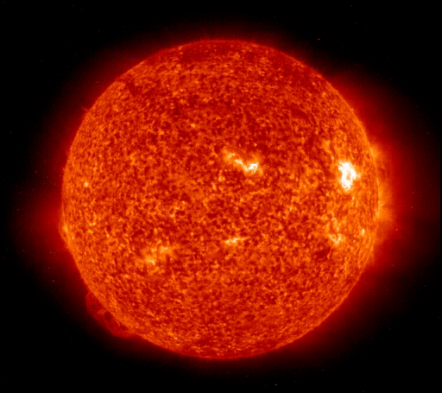
Shine
By NASA’s Extreme ultraviolet Imaging Telescope (EIT) over the course of 6days from 27/6/2005
http://www.boston.com/bigpicture/2008/10/the_sun.html

Slide 4
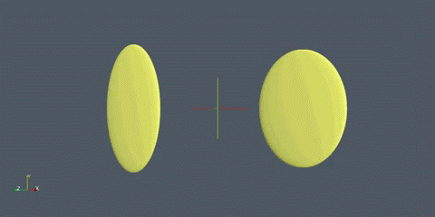
Shine
From Hirano-san’s web page.

Slide 5

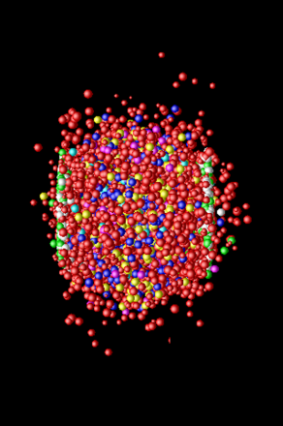
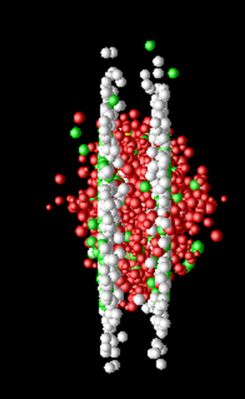
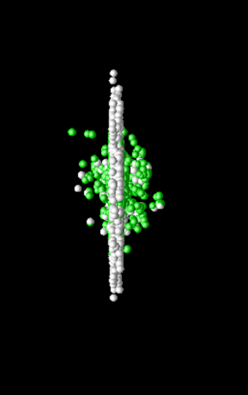
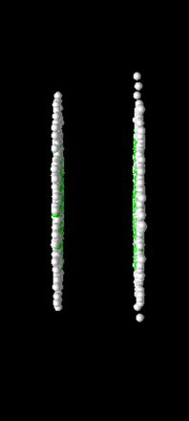
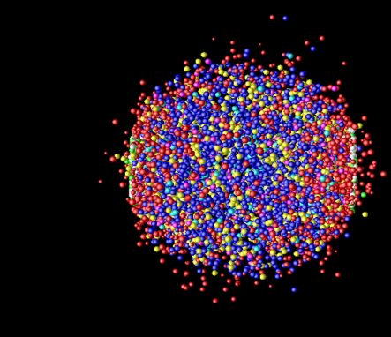
Shining Heavy Ion Collisions
Hadronization
(Freeze-out) +
Expansion
Mixed phase
Thermalization
QGP phase?
Pre-equilibrium
Thermal Photon
Thermal Photon (QGP)
Thermal Photon (HG)
Jet-Photon Conversion
Jet-Bremsstrahlung (QGP)
Jet+Medium
Compton/Annihillation
Fragmentation
Prompt Photon
Time Evolution

Slide 6
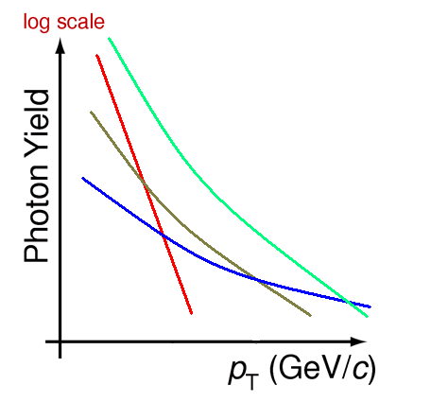
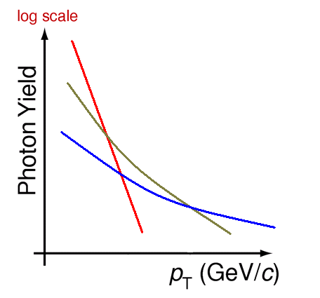
Schematic Spectrum in A+A
Decay photons
thermal:
hard:
1 - 10GeV/c
Thermal Photon
Thermal Photon (QGP)
Thermal Photon (HG)
Jet-Photon Conversion
Jet-Bremsstrahlung (QGP)
Jet+Medium
Compton/Annihillation
Fragmentation
Prompt Photon
+ photons from hadron decay
Photons are collective probes for various expansion stages of the hot matter

Slide 7
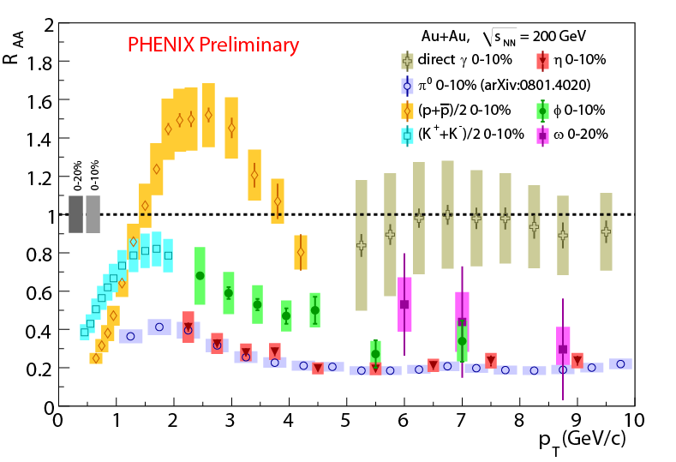
(1) High p_{T} Meson Identification
quark flavor dependent suppression?
  Interesting behavior of nuclear modification for various mesons and hadrons has been reported at RHIC
Photon from meson decay is a good tool of meson identification experimentally at high pT.

Slide 8
(2) Universality
8
Direct photon production in p+p or p+p-bar shows universality
  Consistency with pQCD prediction
  Good probe for initial parton distribution
Preliminary
Any enhancement above the scaling (or pQCD calculation) can be new physics

Slide 9
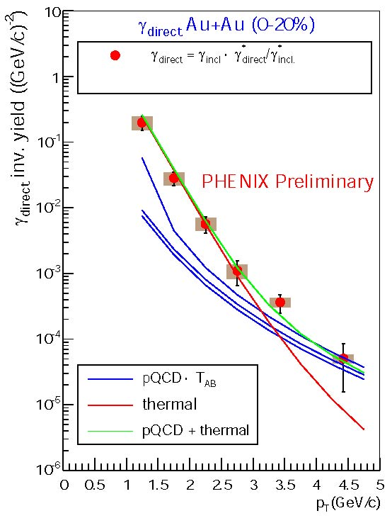
(3) Temperature Sensor
RHIC
LHC Prediction
Indirect Photon Method
First Direct Photon Excess seen at low pT
Temperature from thermal photon measurement results in 300-500MeV
Photon excess is predicted
at pT<10GeV
High multiplicity (~12000 h±/η)
Wide dynamic Range (0.1-80GeV)
Advantage at LHC
Higher temperature, Longer QGP lifetime, Larger background photon suppression

Slide 10
(3) Temperature Sensor
RHIC
In-direct (Internal Conversion) method
First Direct Photon Excess seen at low pT by In-direct measurement at RHIC
For Direct Measurement
Higher Temperature ➔ High Energy=LHC
Improved Experimental Calorimeter
LHC with precise calorimeter and
wide energy coverage (down to 0.1GeV)

Slide 11
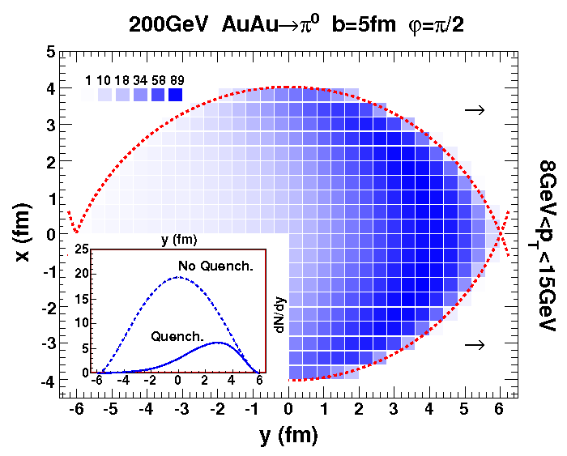
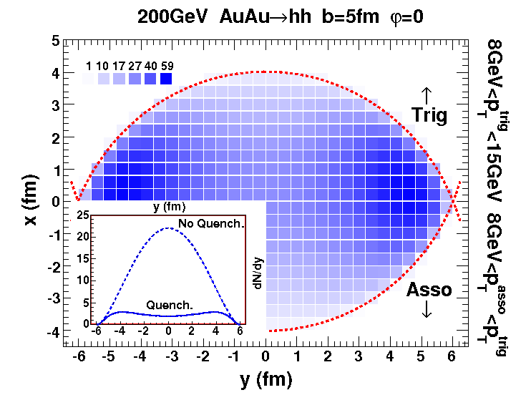
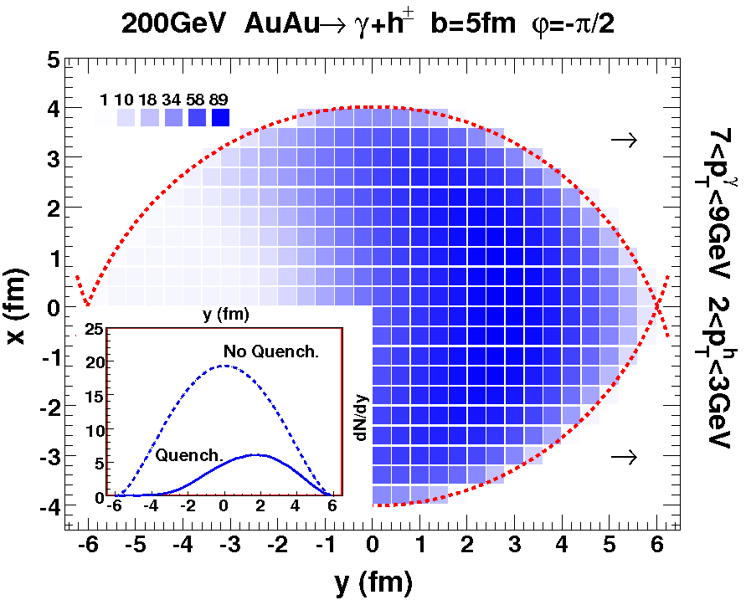
(4) Transparency
Single Hadron Dihadron Gamma-hadron
small z_{T}
SKIN Effect
H.Z.Zhang et al. PRL98(2007)212301 + slides at ATHIC08
Probe to the center of hot matter
E_{photon} = E_{Jet}

Slide 12
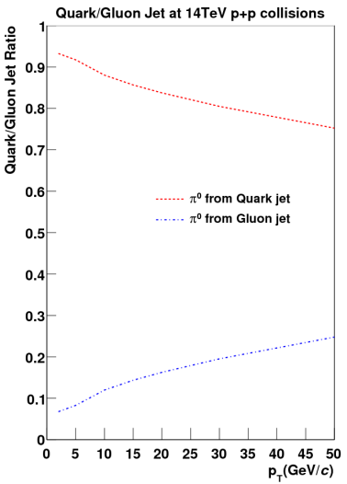
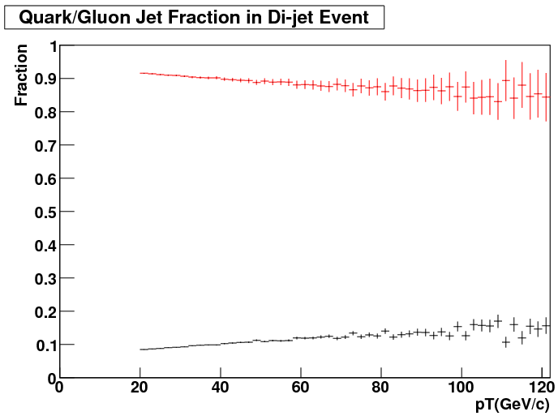
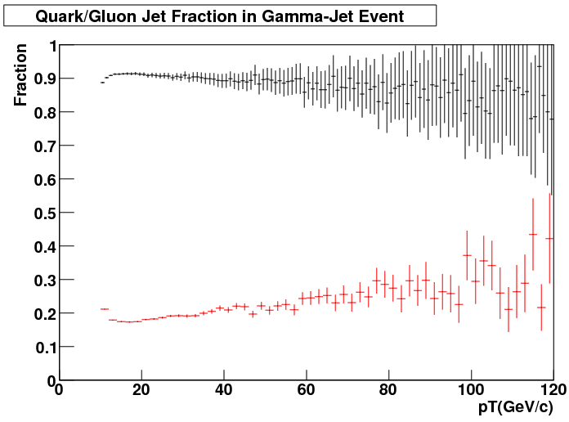

(5) Parton Identification
Naively, gluon jet is quenched more than quark jet
  Strong Interaction Color Factor C(A) : C(F) = 3 : 4/3
Comparison between gluon and quark
➔ Extream test of quenching effect
Single/Di-Hadrons/Jets
Photon-Hadrons/Jets
PYTHIA
Pi0 at 14TeV
PYTHIA 5.5TeV
PYTHIA 5.5TeV
Gluon Dominant
Quark Dominant
Quark jet identification

Slide 13
shadow
(n) A dark shape that someone or something makes on a surface when they are between that surface and the light
[by longman dictionary]

Slide 14
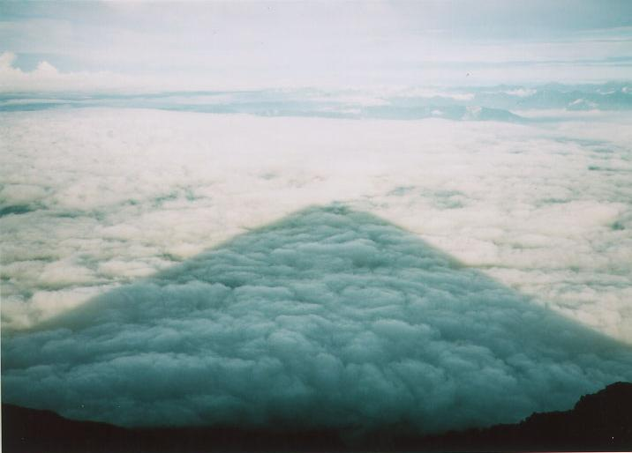
Shadow
日本一大きな影
Largest shadow in Japan!!!
Taken from the top of highest mountain in Japan, Mt. Fuji.
Taken by H.T. in 1996 summer.

Slide 15
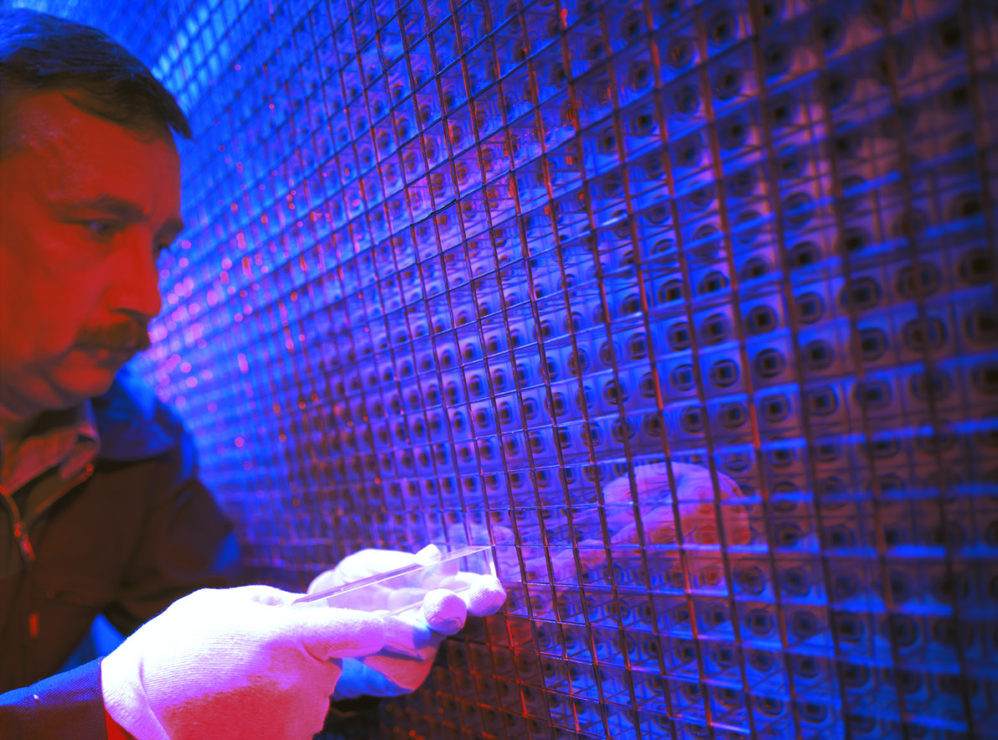
Shadow
世界一高性能の(GeV光子)電磁カロリーメータ
Finest GeV-photon calorimeter in the world

Slide 16
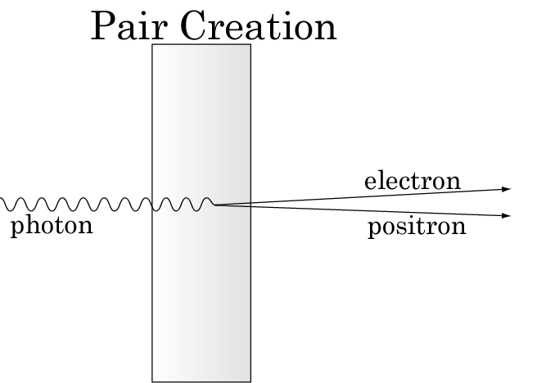
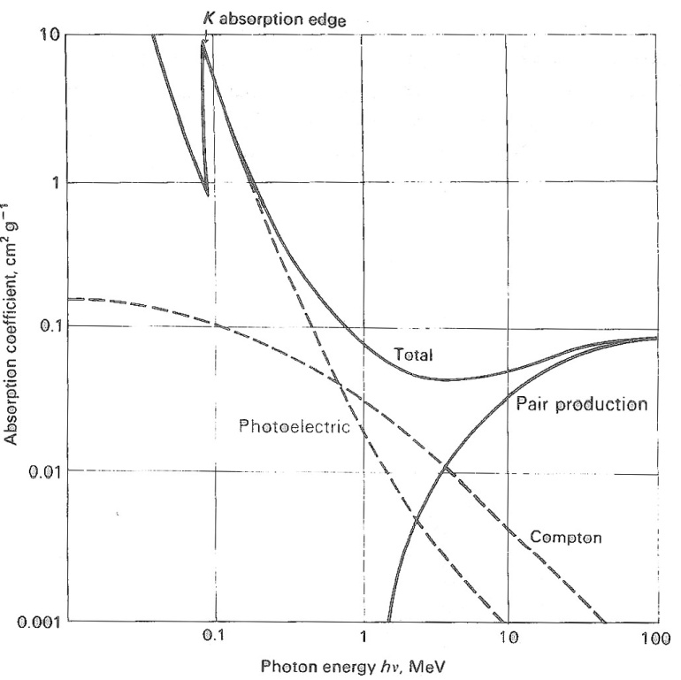
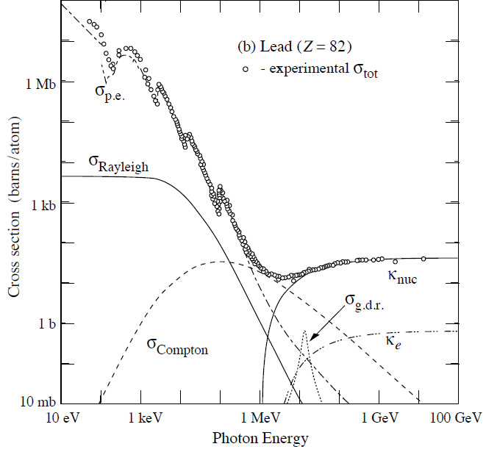

Electro-Magnetic Interaction
photon
L-Shell
K-Shell
Photon lose energy or convert into electron by
“Photoelectron absorption ( γ+atom → ion+e⁻)”
“Compton ( γ+e⁻ → γ+e⁻)” process
2M_{e}
Pair creation dominates at > 10MeV (for Pb)
(cut of > 2M_{e})
Pair production probability after X0[cm] length is 1-e^{-7/9}=54%.

Slide 17
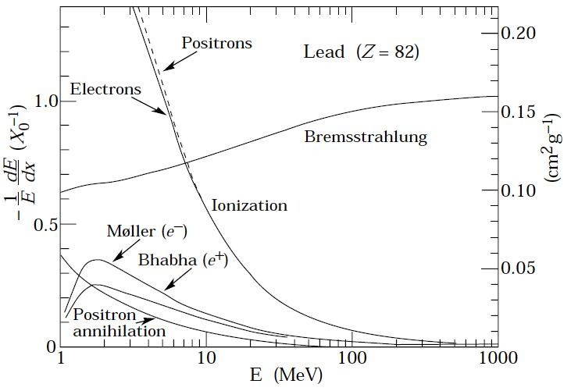
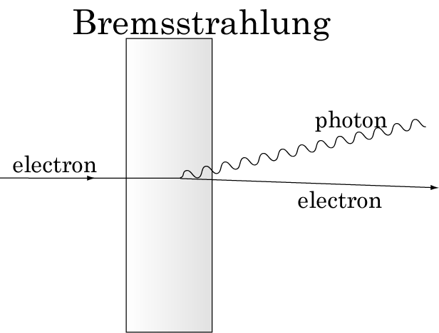
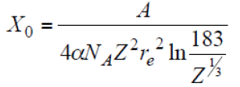
Electro-Magnetic Interaction
electron/positron
Critical Energy
Energy loss by bremsstrahlung is characterized by “Radiation Length”
(in the high energy limit where the ionization loss can be neglected)
dE/E = - dx/X₀ ➔ <E> = E₀*exp(-x/X₀)
Critical Energy (E_{c}) : “Ionization loss = Bremsstrahlung loss”
E_{c}=6.9MeV for Pb
If the energy is less than E_{c}, the e-/e+ lost

Slide 18
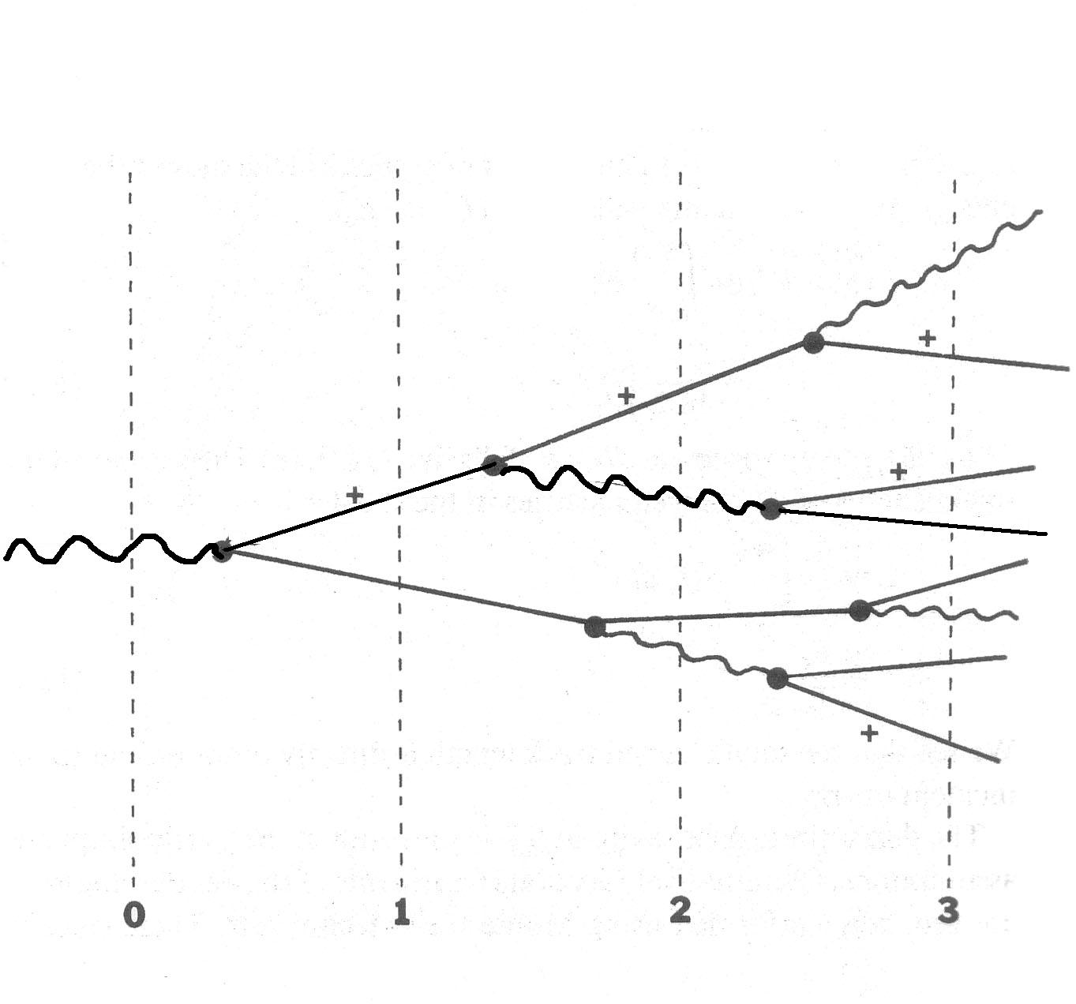
Electro-magnetic Shower
photon
One pair creation on average after X₀, Ee⁺≅ Ee⁻ ≅E₀/2
e⁺ and e⁻ radiate one photon after X₀.
e⁺ and e⁻ deposit “ionization energy” through matter
Continue 1-3 until Ee⁺≅ Ee⁻ is below the critical energy(Ec)
  Electron <Ec stop after ~0.5cm(for Pb) due to ionization loss
  Number of shower particles (2^{d}) increases exponentially with depth(d)

Slide 19
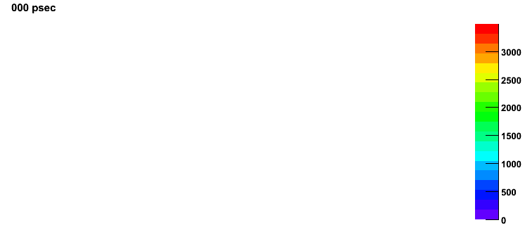
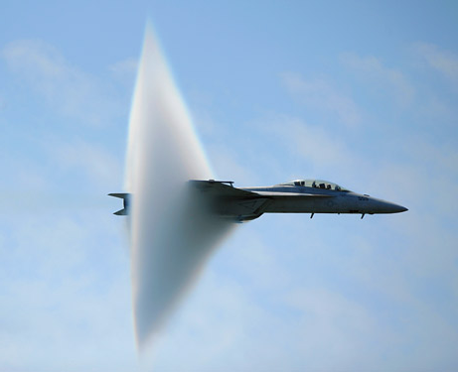
In real life…
MeV/2cm²
100GeV photon

Slide 20
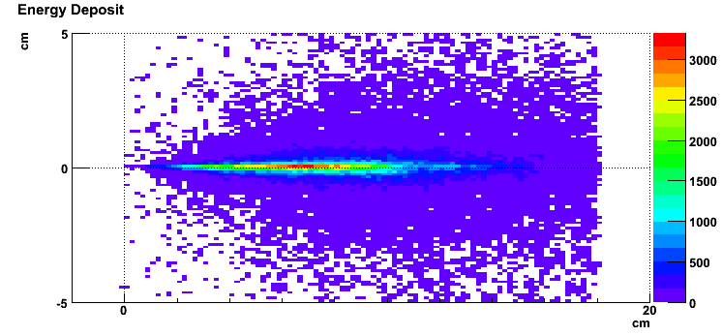
How to Collect the Deposited Energy?
MeV/2cm²
Collect Ionization energy loss (or Cerenkov light) by e⁺ and e⁻
Two type
  Inhomogeneous or Homogeneous
    Inhomogeneous
      Sandwich with “heavy material” + “ionization energy loss detector”
    Homogeneous
      “heavy material” itself is “ionization energy loss detector”

Slide 21
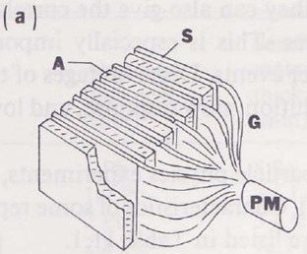
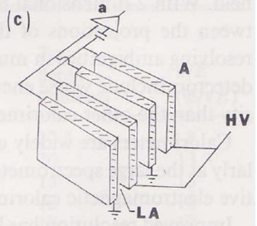
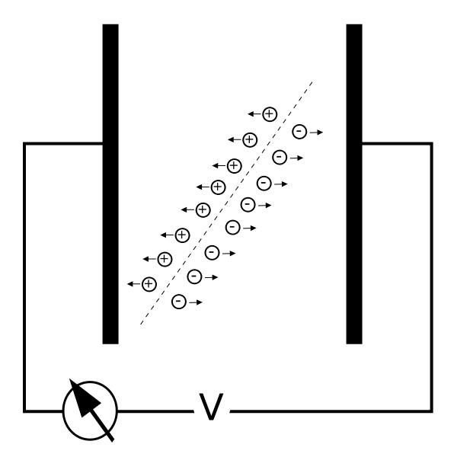
Inhomogeneous Calorimeter
Inhomogeneous : Sampling Calorimeter
  Metal + “ionization energy loss detector”
    Some exception is to utilize Cerenkov light emmission.
  Disadvantage: “ionization energy loss” in metal is not detectable.
  Three types for “ionization energy loss detector”
      Solid or Liquid or Gas
Solid(Silicon), Liquid( ex. LiAr), Gas(Ar+Co2, etc)
      Solid : Organic scintillator

Slide 22
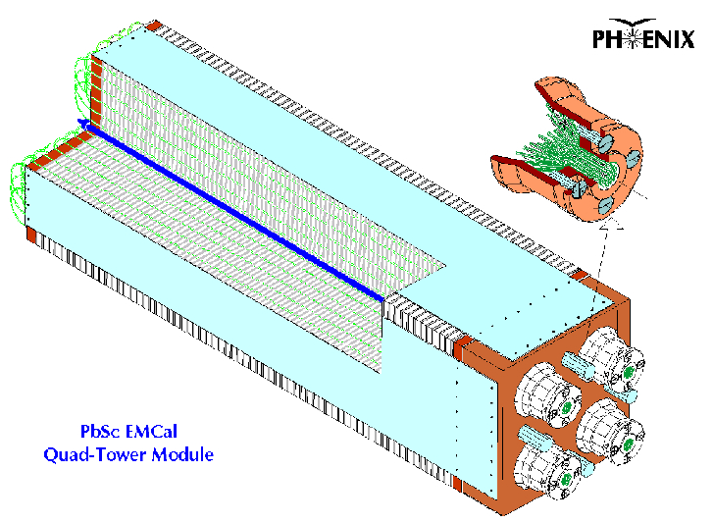

Example of Inhomogeneous Type
PHENIX PbSc Calorimeter
Shashlik type calorimeter
シシケバブ：四角形の肉を串に刺して焼いたトルコ料理

Slide 23
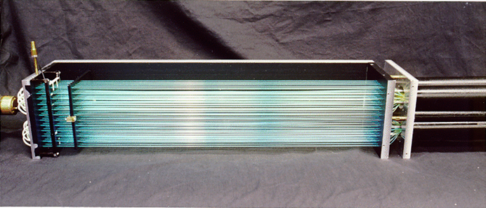
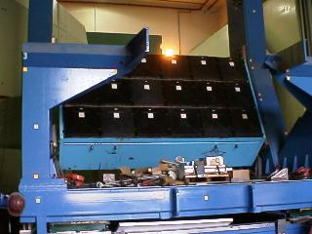
Example of Inhomogeneous : PHENIX PbSc
  Organic Scintillator
    5cm x 5cm x 4mm(thickness)
    Aluminum vapor edge on four edge, one cornor is remained open for monitoring light input.
    Scintillation light are gathered through wave length shifter fibers and collected into a PMT.
PbSc sector 2.0m x 4.0m

Slide 24
Homogeneous Type
Homogeneous : Crystal Calorimeter
  Crystal itself is “ionization energy loss detector”
    NaI, CsI, Bi4G, GSO, BGO, PbWO4, LYSO
    Scintillation radiation
  Some exception is a glass (PbGl) as a Cerenkov radiator

Slide 25
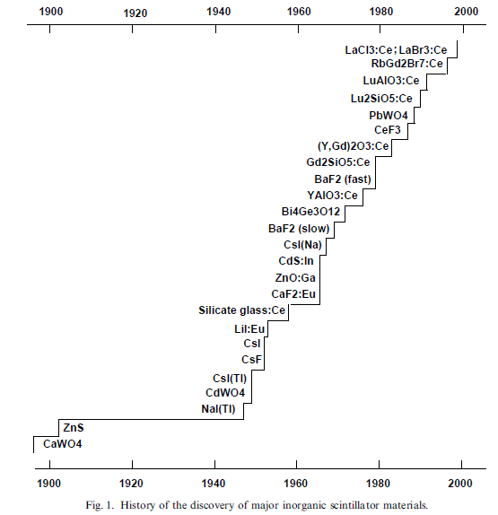
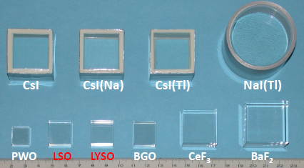
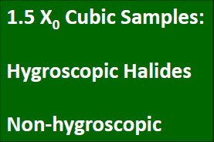
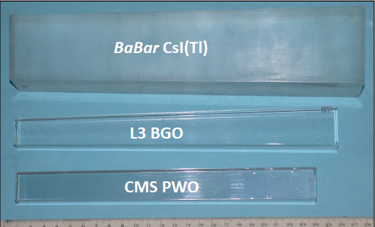
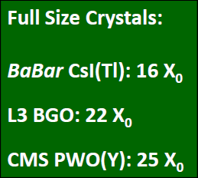
Crystal Development
~100 years development
Slide by Ren-Yuan Zhu at CALOR2008
M.J.Weber, J.Lumin 100(2002)35

Slide 26
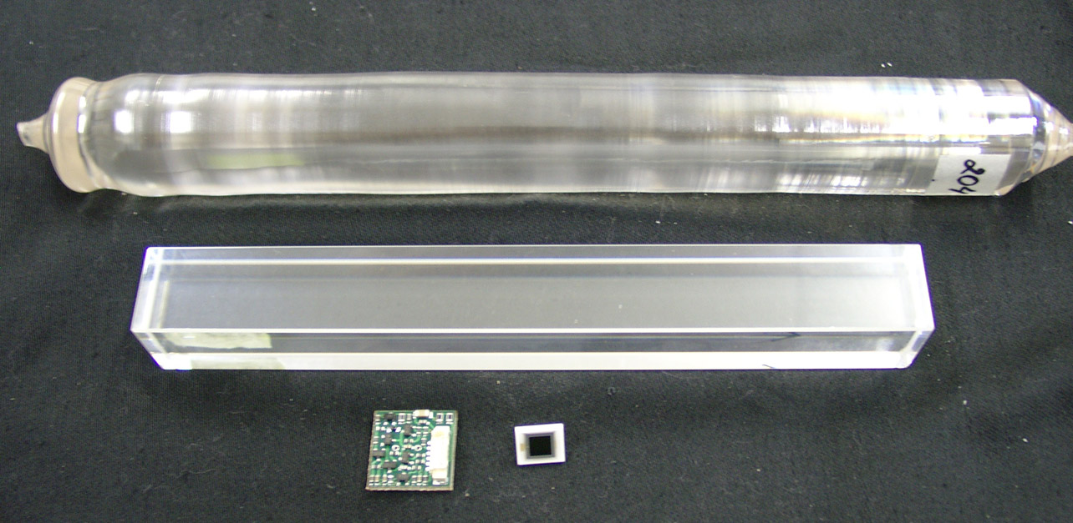
Example of Homogeneous Type: PHOS
18cm
2.2x2.2cm²
CSP preamplifier
(FET based, 2x2cm)
PbW0₄ crystal
APD(5x5mm)
Avalanche Photo Diode (APD) + Preamp
  Hamamatsu Co., ~7,000yen/APD+~8,000yen/Preamp
  S8148/S8664-55
  High Q.E.(60%-80%)
  Low noise and capacitance
  Thin photo-sensor
  Operational at low temperature and in magnetic field
PbWO₄ Crystal
  22 x 22 x 180 mm³, ~20,000yen/crystal
  ~2cm Moliere Radius, 20X₀, 8.2g/cm³
  Scintillation light (400nm-500nm)
  Operation at -25deg → 25ns decay,230pe/MeV
  With APD acceptance:
  4.5pe/MeV@-25deg, 1.45pe/MeV@+20deg.
  North Crystal Co. Apatity in Russia

Slide 27
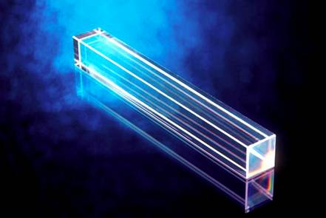
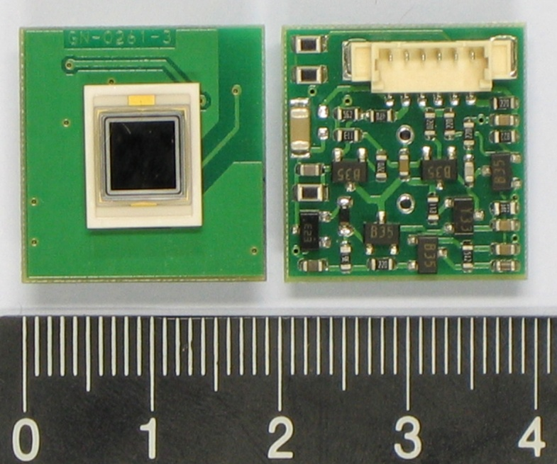
Example of Homogenous Type : PHOS
PbWO4 Crystal
  Fast Signal (~nsec)
  Operation at -25deg ➔ 3 times large scintillation photon
  Smaller Moliere Radius (2cm)
  ➔ Good 2 photon Separation
2x2cm2
5mmx5mm
Avalanche Photo Diode (APD)
5x5mm
Preamplifier
  High Q.E.(60%-80%)
  Thin photo-sensor
  Operational in magnetic field
APD: Hamamatsu S8148/S8664-55

Slide 28
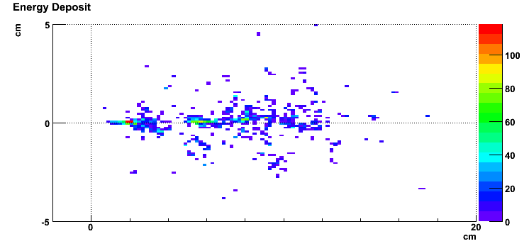
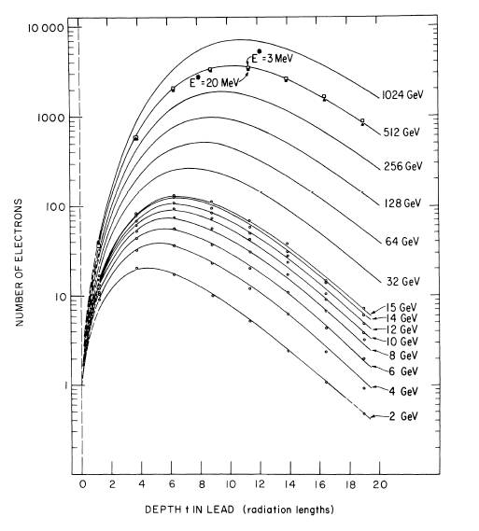
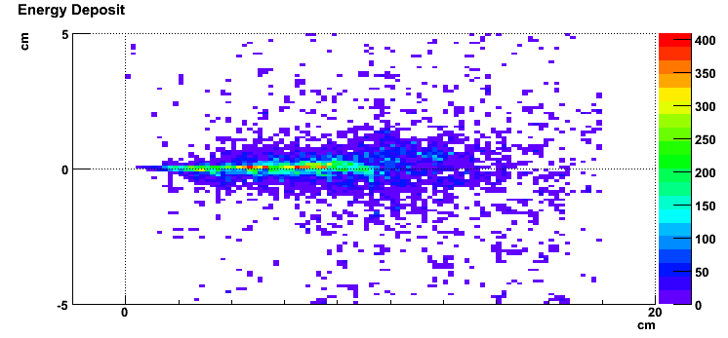
Detector Performance Requirement(1)
< Linearity >
1GeV photon
Larger energy photon produces deeper shower
Uniform detection and collection of the deposited energy plays an important role in detector performance, especially energy measurement linearity and energy resolution at high pT.
<keyword> is
Uniformity
10GeV photon
100GeV photon

Slide 29
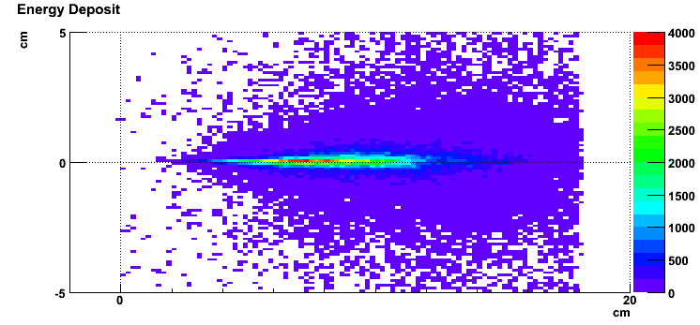
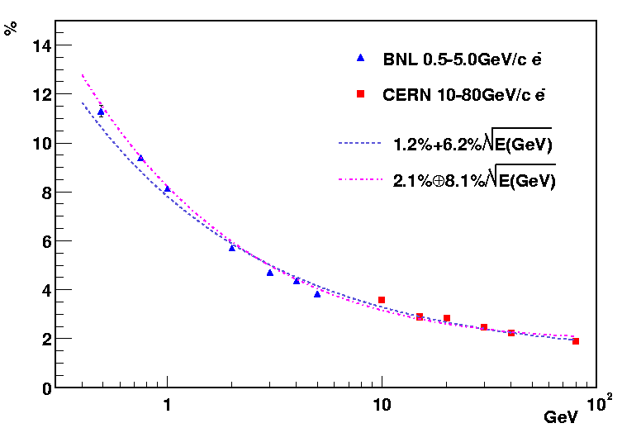
Detector Performance Requirement(2)
<Energy Resolution>
100GeV photon
Shower Leackage
<keyword> is
Enough Size
From deposited energy into detectable object
ex. Number of scintillation photon
“The detectable object carry out part of all energy”
Statistical fluctuation ➔ Energy resolution ∝1/√E
<keyword> is
Efficient “ionization loss” detector
ex. large light emission, good efficiency, good sampling ratio
PHENIX PbSc
Energy Resolution

Slide 30
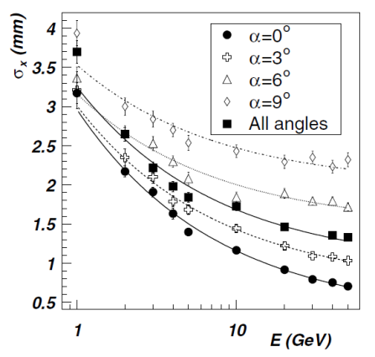
Detector Performance Requirement(3)
<Position Resolution>
100GeV photon
fluctuation
fluctuation
ALICE PHOS
Lateral position Res.
Center of gravity is the measurement of the incident position and angle, which are affected by the lateral and longitudinal fluctuation.
<keyword> is
Small Radiation Length
Compact shower == small fluctuation
Measurement of fluctuation is another keyword.

Slide 31
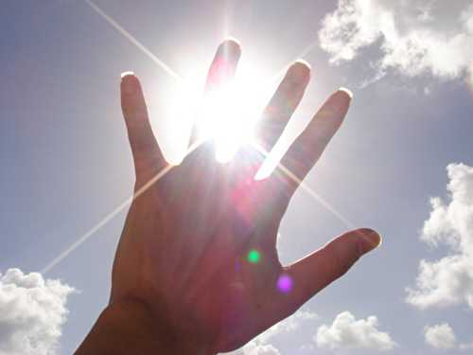
Time to measure shine(photon) by shadow(calorimeter) from QGP at LHC

Slide 32




Heavy Ion Collisions at LHC
p+p √s =14 TeV
Pb+Pb √s_{NN}=5.5 TeV/A
Energy LHC = 28 x RHIC =320 x SPS = 1000 x AGS
ＣＭＳ実験
ＬＨＣ-ｂ実験
ＡＴＬＡＳ実験
ＡＬＩＣＥ実験

Slide 33






ALICE at Point-2
The ALICE Experiment
30 countries, 97 institutions, ~1,015 members as of Jan.2007
1000th ALICE member

Slide 34


Collaboration:
> 1000 Members
> 100 Institutes
> 30 countries
Detector:
Size: 16 x 26 meters
Weight: 10,000 tons

Slide 35

ALICE Installation Status in 2009
EMCAL
Complete:
ITS, TPC, TOF, HMPID,
FMD, T0, V0, ZDC,
Muon arm, Acorde
PMD , PHOS(3/5), DAQ
Partial installation:
7/18 TRD
4/12 EMCAL
~ 60% HLT
PHOS

Slide 36



Photon Detectors at LHC
Exp. | ATLAS |  | CMS |  | ALICE
Name | LAr Barrel | LAr Endcap | ECAL(EB) | ECAL(EE) | PHOS | EMCAL
Structure | Liquid Ar |  | PWO + APD |  | PWO + APD | Pb + APD
Coverage | 0<|η|<1.4, 2π | 1.4<|η|<3.2, 2π | 0<|η|<1.5, 2π | 1.5<|η|<3.0, 2π | |η|<0.12, 0.6π | |η|<0.7, 0.6π
Granularity ΔηxΔϕ | 0.003x0.100 0.025x0.025 0.025x0.050 | 0.025x0.100 0.025x0.025 0.025x0.050 | 0.0174x0.0174 | 0.0174x0.0174 to 0.05x0.05 | 0.004x0.004 | 0.0143x0.0143
Res. | 10%/√E⊕0.5% | 10%/√E⊕0.5% | 2.7%/√E⊕0.55% | 5.7%/√E⊕0.55% | 3.3%/√E⊕ 1.1% | 7%/√E⊕1.5%
Cover Jet Size
Two Separation
Cover Low Energy
PHOS for low energy photon, EMCAL for jet energy

Slide 37

PHOS Calorimeter
PbWO₄ Crystal
  Fast Signal (~nsec)
  Operation at -25deg
  Smaller Moliere Radius (2cm)
  ➔ Good 2 photon Separation
Combination of recent high technology.
18cm
Total 17920 channel
  100deg -0.12<η<0.12
PbW0₄ crystal
2.2x2.2cm²
Avalanche Photo Diode (APD)
  High Q.E.(60%-80%)
  Thin photo-sensor
  Operational in magnetic field
2x2cm
~12.5ton
APD: Hamamatsu S8148/S8664-55
3/5 modules for 2009 runs
Under cosmic commissioning
5x5mm
約７m

Slide 38


EMCAL Calorimeter
Pb/Sc Shashlik
77 x (1.44mm Pb + 1.76mm Sci.)
6.0x6.0x24.6cm³ active vol.
Approved 12/2008
10+2/3 Super Modules
  110deg -0.7<η<0.7
Avalanche Photo Diode (APD)
  High Q.E.(60%-80%)
  Thin photo-sensor
  Operational in magnetic field
~85ton
2x2cm
Four SM for 2009 run
Complete for 2011
Under cosmic commissioning
APD: Hamamatsu S8148/S8664-55
5x5mm

Slide 39





Photon Spectrometer (PHOS)
High-granularity, high-resolution EM calorimeter
  64x56x5 PbWO₄ crystals readout with APD/CSP
  Precise measurement of photons and neutral mesons
  level-0 and level-1 trigger
  Partial installation 3/5 as of 2009
64x56 matrix
HUST & CCNU

Slide 40

PHOS Calorimeter
~3% fluctuation term is best value in the world for the working calorimeter.
Well controlled performance (energy resolution)
from 150MeV to 200GeV

Slide 41




Physics Potential: Neutral Pion in p+p
WA98(CERN)
PHENIX(BNL)
ALICE(CERN)
π0 (E=5-6GeV)
(π⁻+¹²C→π⁰+X)
p+p 200GeV run2
p+p 14TeV
GEANT simulation
Pb+Pb 13GeV
nucl-ex/0108006
13MeV width of π⁰@1GeV/c
5-6MeV
Improvement of particle identification compared to the other HI exp.

Slide 42


The Challenge in RHI Experiments
Pb+Pb at √s_{NN} = 5.5 TeV at ALICE
p+p at √s = 14 TeV at ALICE

Slide 43



Physics Potential: Neutral Pion in Pb+Pb
Expected π⁰ peak in central Pb+Pb HIJING
Enough large significance for π⁰ .
  more species (η, ω, K⁰_{s}) under study
p_{T} = 3 GeV/c
p_{T} = 4 GeV/c
p_{T} = 5 GeV/c
p_{T} = 6 GeV/c
p_{T} = 7 GeV/c
p_{T} = 8 GeV/c
p_{T} = 9 GeV/c
p_{T} = 10 GeV/c
w/o γID
w/o γID
See talk (14th/Oct, Session BB-11) by Kenta Shigaki

Slide 44

Physics Potential: LHC First Pb+Pb Year
RHIC 10 years and LHC 1st HI year

Slide 45



Physics Potential: Thermal Photon
expected signal/background ratio
  4 ~ 10 % (3 GeV/c) – 25 ~ 50 % (10 GeV/c)
expected systematic error with ALICE/PHOS
  8.9 % (2 GeV/c) – 5.7 % (10 GeV/c)
Without Jet Quenching
Systematic error in thermal photon measurement is well smaller than statistic error at the pT>3GeV/c

Slide 46


Current LHC RUN Plan
CERN DG message in Feb. 2009 from the Chamonix workshop:
“… foresees first beams in the LHC at the end of Sept. this year, with collisions following in late Oct. A short technical stop over Xmas period. Then run through to autumn next year, ensuring data … first new physics analyses … the possible collisions of lead ions in 2010.”
Prof. Rolf-Dieter Heuer, DG
DRAFT
2009:
  1 month commissioning
2010:
  1 month pilot & commissioning
  3 month 3.5 TeV
  1 month step-up (to be decided)
  5 month 4 - 5 TeV
  1 month ions
DG message in Feb. 2000 that
“The challenge now passes to RHIC and later to CERN's Large Hadron Collider."
Notes:
さて、これまでに生じた問題とその解決策ですが、大きく括ってこの3点です。
最大の問題点は加速器完成の遅延です。本研究の当初計画では、2007年にLHC加速器完成を想定していましたが、1年遅れの2008年9月に完成を迎えたことはマスコミ報道などを通してご存知と思います。期待以上の立ち上がりを見たのもつかの間、思わぬ重大故障に見舞われ、運転再開を約1年待つことになりました。
つい先日までの信頼すべき情報では、10月初旬陽子衝突、翌10年夏には鉛原子核衝突が予定されていました。ところが、真空系のトラブルが発生し、ビーム入射が約1.5ヶ月遅れます。それでも、順調に進めば、10年度には鉛原子核衝突実験を遂行できると見込んでいます。今後も余談を許さぬところですが、私たちは、与えられた条件の中で最善の結果を求めて最大限の努力を続けます。
2番目に、第4/5号機のPWO結晶供給がロシア側で進んでいません。現地調査をして頂いた頃から気づいていた問題ですが、決定的になったのは、昨年の世界経済破綻です。現在、この問題は私たちの手を離れ、CERN所長とロシア財務担当との間で検討中と聞きます。検出器数が足りないことによる影響ですが、先程話しました検出機内の物質量削減により大幅に光子収量を回復することができ、物理成果に与える影響はあまりないことが分かっています。
3番目は私たちの検出器固有に生じた問題です。筐体内結露や読み出し系不調などを経験しましたが、何れも問題の完全に理解をしたうえで、根本的な解決策を取りました。

Slide 47


Let’s follow rabbit to wonderland!!!

Slide 48

Thank you
I’m here!!!

