Slide 1
Selected highlights from QM2014
--- 19-24/May/2014, Darmstadt, Germany ---
ShinIchi Esumi, Univ. of Tsukuba
contents
pPb at LHC, dAu at RHIC
HF, jet, flow and fluctuation
energy scan
Many thanks to H. Masui, T. Niida and T. Todoroki (Tsukuba)
for fruitful discussions

Slide 2
Anne Sickles, 22/May

Slide 3
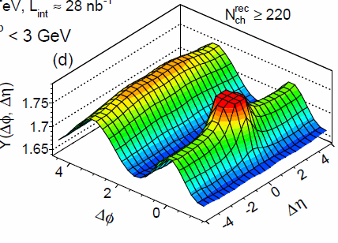
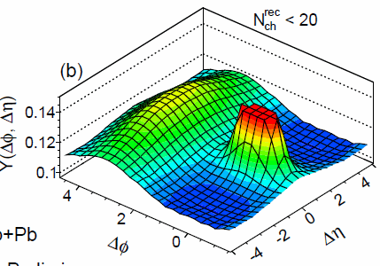
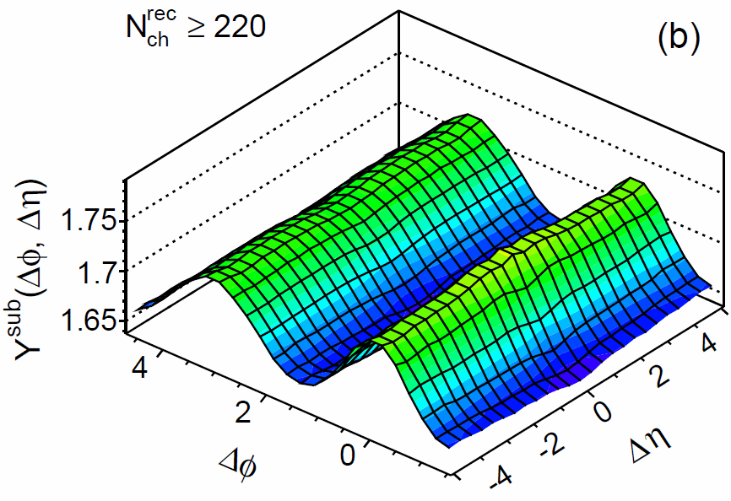
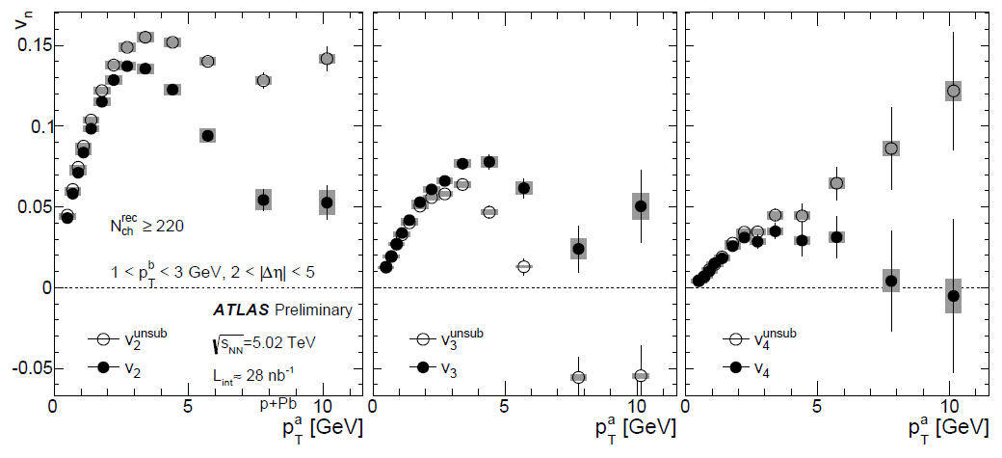
p+Pb
Sooraj Radhakrishnan ,
20/May, cor./flu.
v₂
v₃
v₄

Slide 4
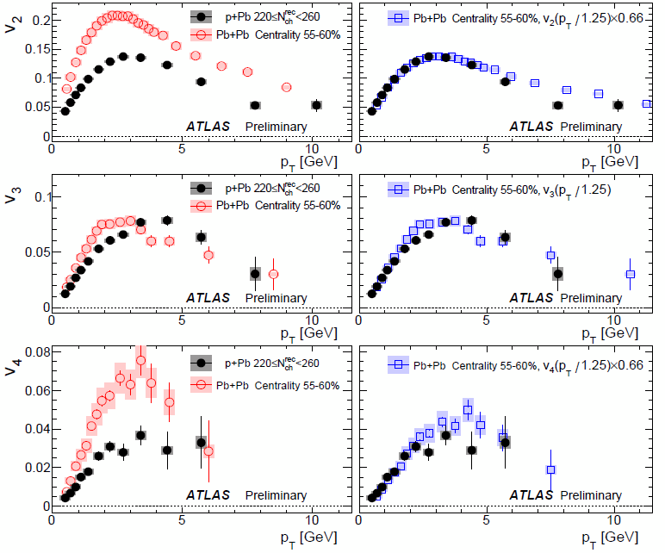
[p + Pb]
vs
[Pb + Pb]
v_{n}(p_{T}) shapes are all similar.
Sooraj Radhakrishnan,
20/May, cor./flu.

Slide 5
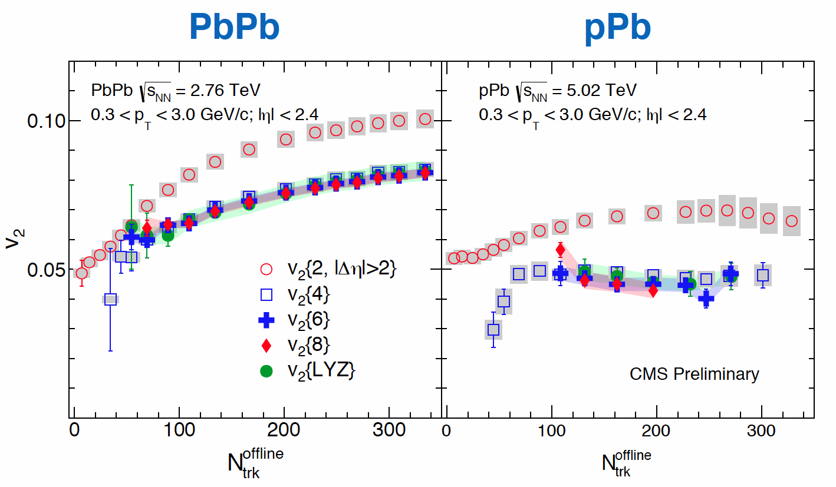
Quan Wang,
20/May, cor./flu.
multi-particle cumulant results
v₂{n} with higher n are all similar.

Slide 6
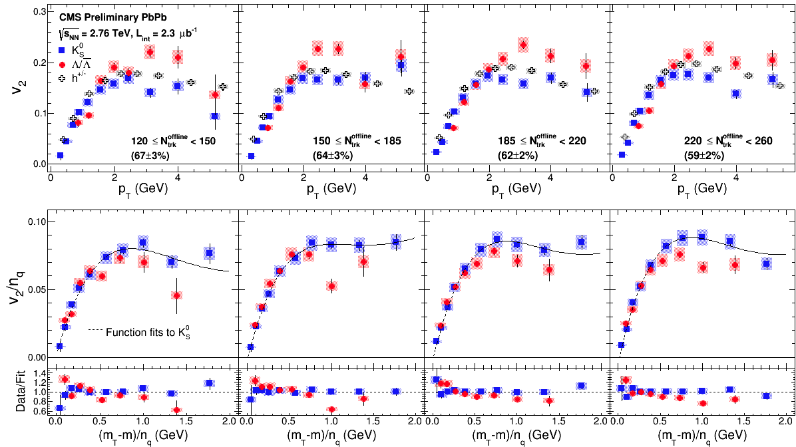
Comparison between Pb+Pb and p+Pb at the same multiplicity
for PIDed v₂ as a function of pT
Monika Sharma,
20/May, cor./flu.
Pb+Pb
p+Pb
Monika SHARMA
mass- and baryon-meson dependences are all similar
or even larger splitting for pA?

Slide 7
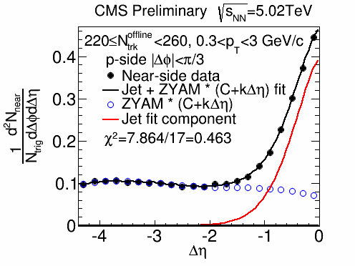
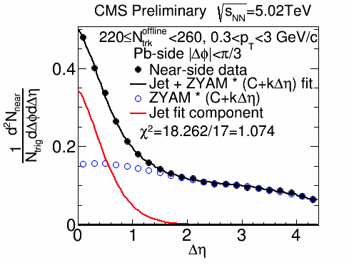
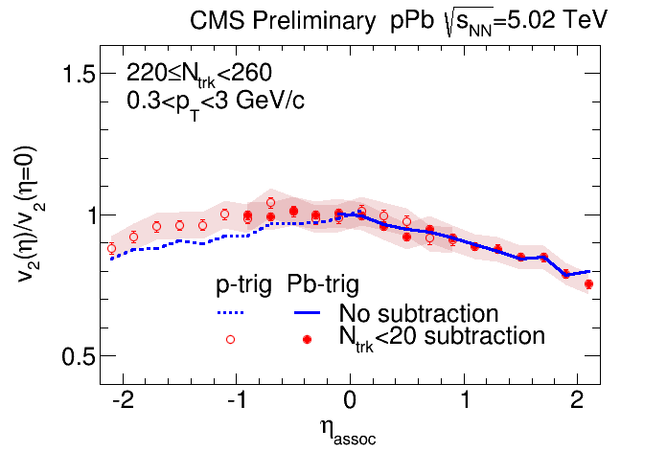
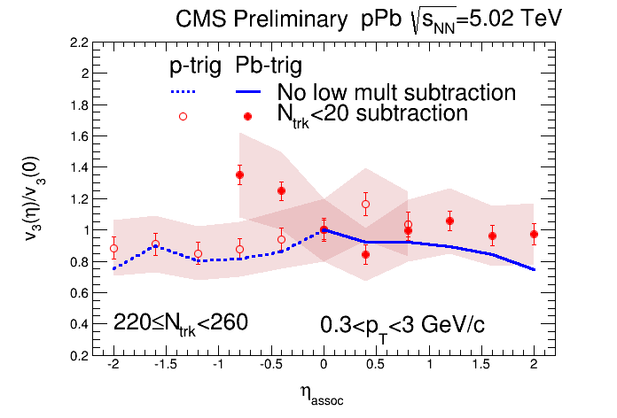
p+Pb
v₂
v₃
Lingshan Xu,
20/May, cor./flu.

Slide 8
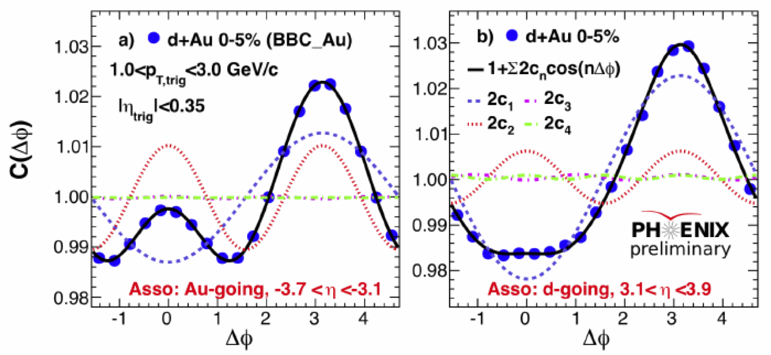
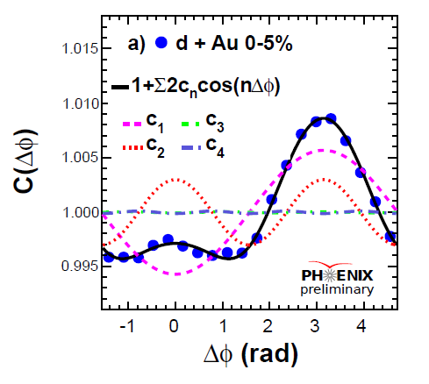
Backward - Central
correlation
Forward - Central
correlation
200GeV d + Au
at RHIC-PHENIX
Forward - Backward
Correlation with |Δη| > 6.0
Au-going : -3.7 < η < -3.1
d-going : 3.1 < η < 3.9
Shengli Huang,
20/May, cor./flu.

Slide 9
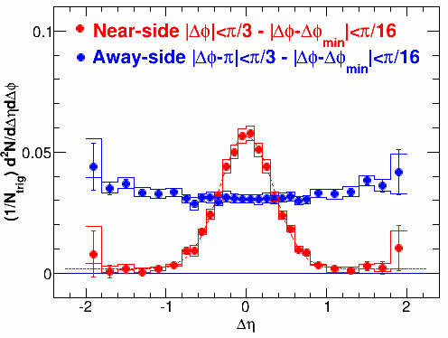
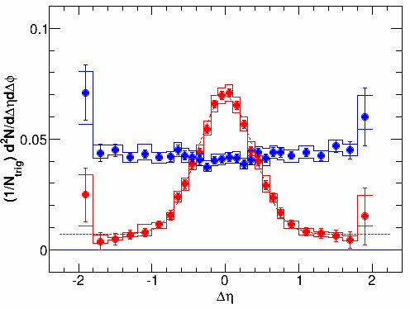
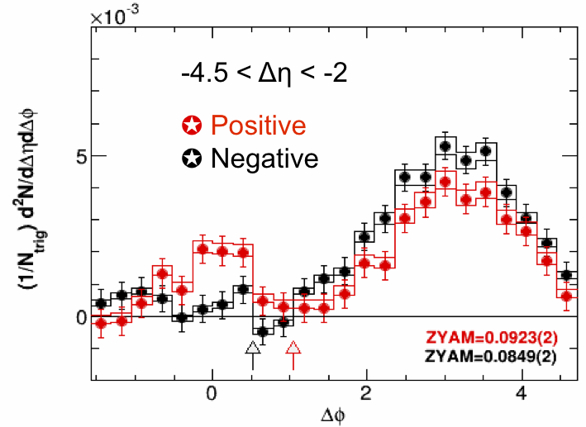
40-100%
0-20%
200GeV d + Au
at RHIC-STAR
STAR Preliminary
STAR claims
no flow effect
in dAu.
Yi Li,
19/May, initial state

Slide 10
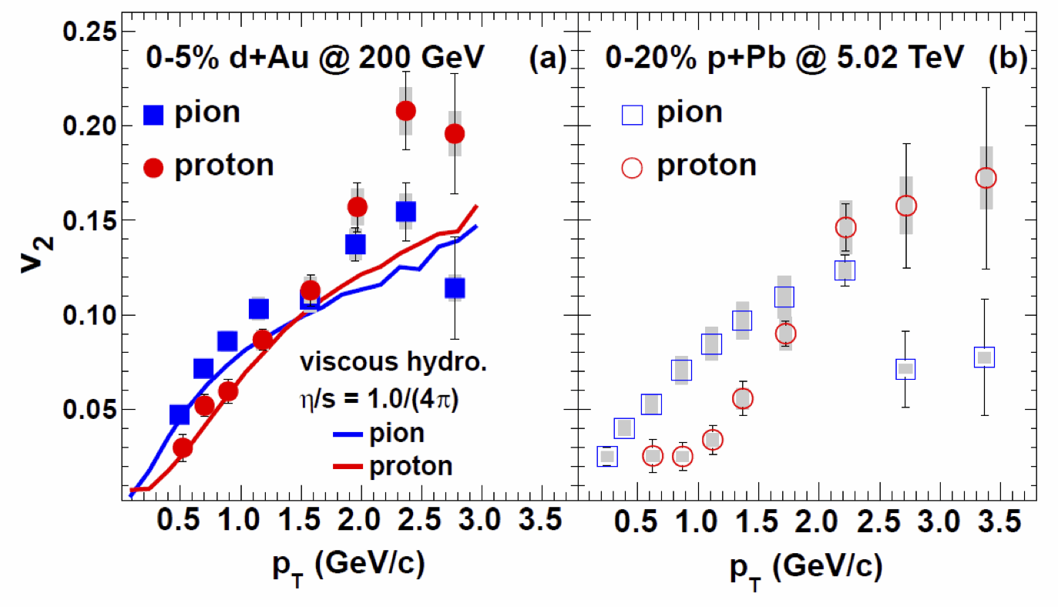
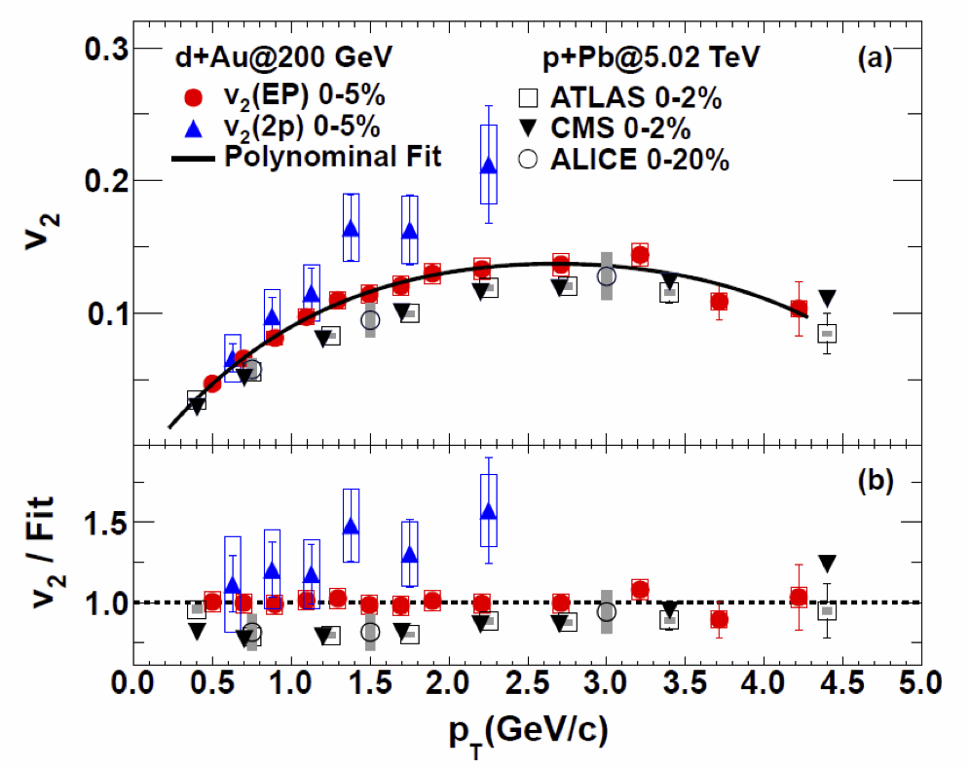
200GeV d + Au
at RHIC-PHENIX
peripheral subt.
two PHENIX results
2P : two particle within |η|<0.35
and peripheral subtracted
EP^{MPC} : resolution is determined
via 3-sub event correlations
Φ₂^{central arm [|η|<0.35]}
Φ₂^{Au-side MPC [-4<η<-3]}
Φ₁^{Au-spectator ZDC} ^{[η<-5]}
Shengli Huang,
20/May, cor./flu.

Slide 11
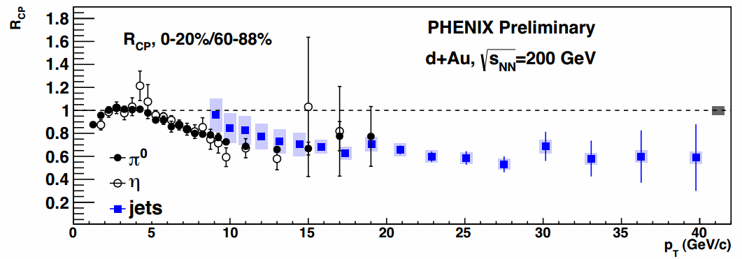
Jet suppression in dAu?
Sarah Campbell,
19/May, collective

Slide 12
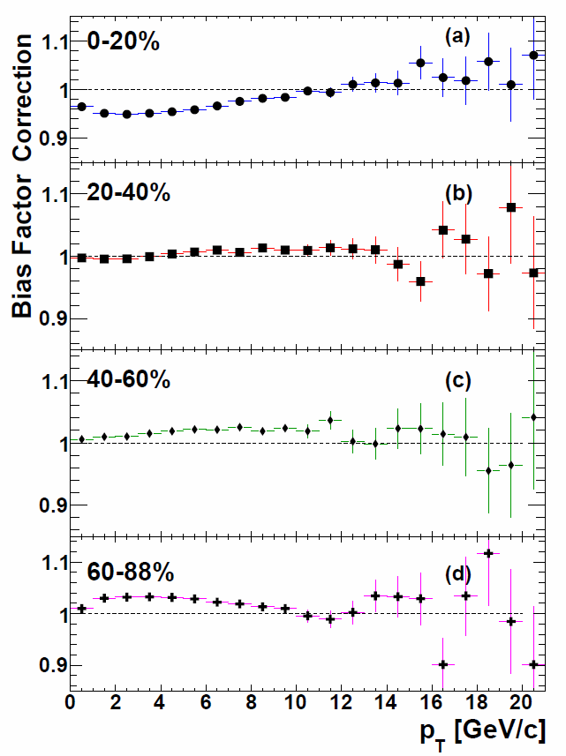
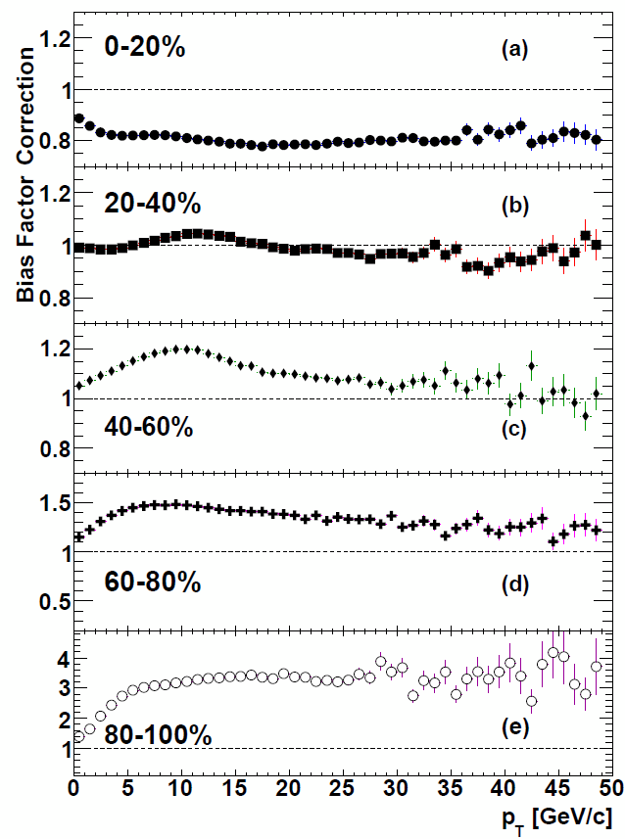
Bias test at dAu (RHIC) and at pPb(LHC) with Hijing
Sarah Campbell,
19/May, collective
arXiv:1310.4793

Slide 13
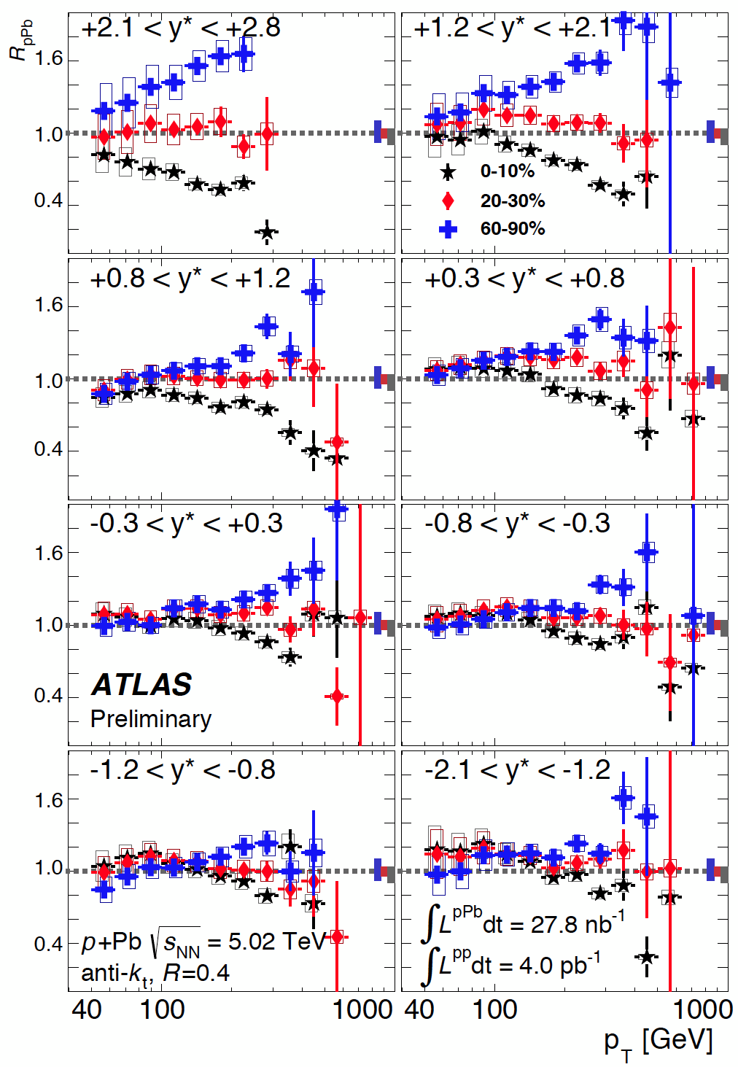
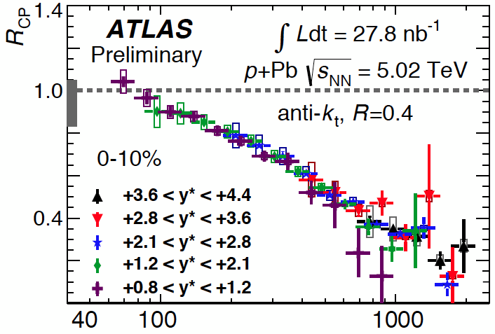
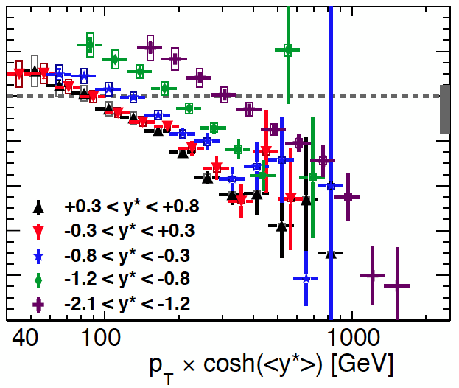
Jet suppression in central pPb?
or enhancement in peripheral?
Dennis Perepelitsa,
20/May, Jets

Slide 14
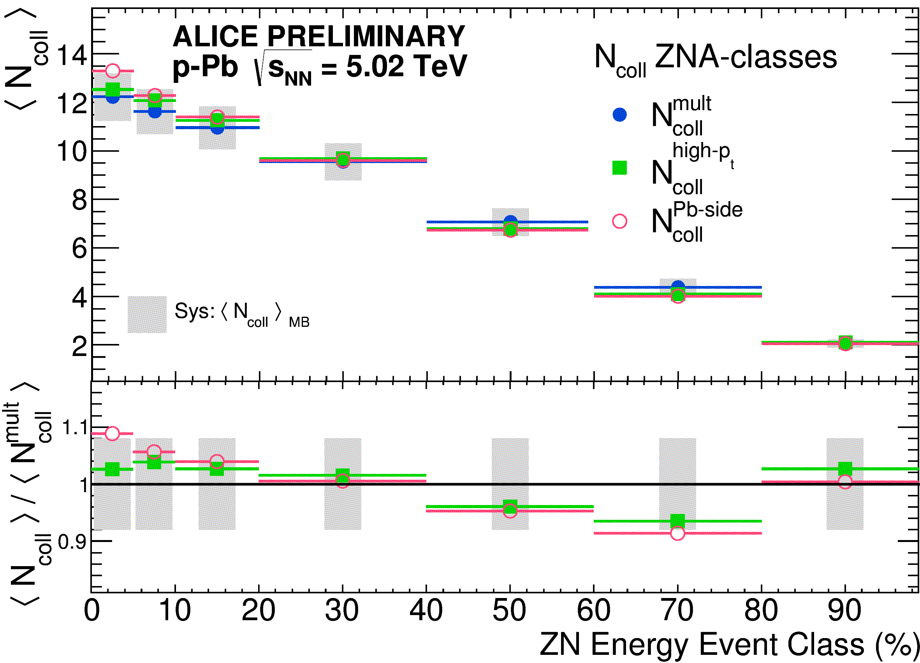
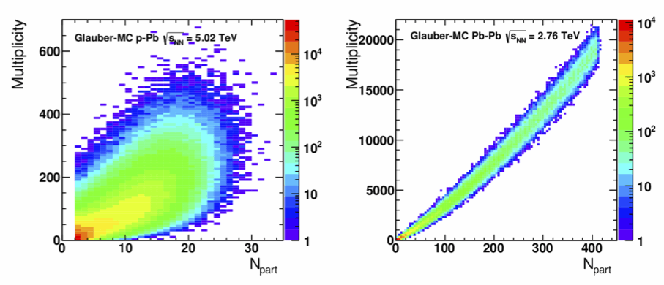
Centrality Event Class
definition in pA
Alberica Toia,
19/May, Initial state
Assumption:
Mid-rap dN/dh scales with N_{part}
(= N_{coll} - 1 in pA)
Pb-side dN/dh scales with N_{part}^{target}
(= N_{coll} in pA)
Yield at high-pT scales with N_{coll}

Slide 15
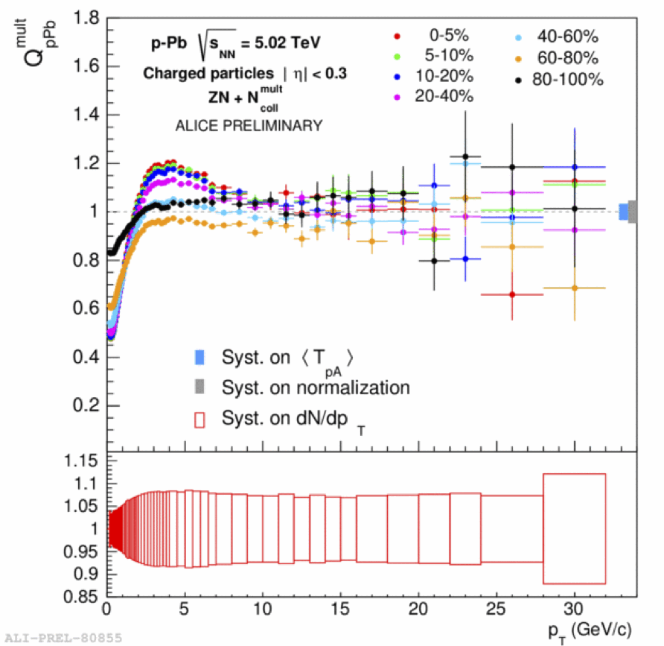
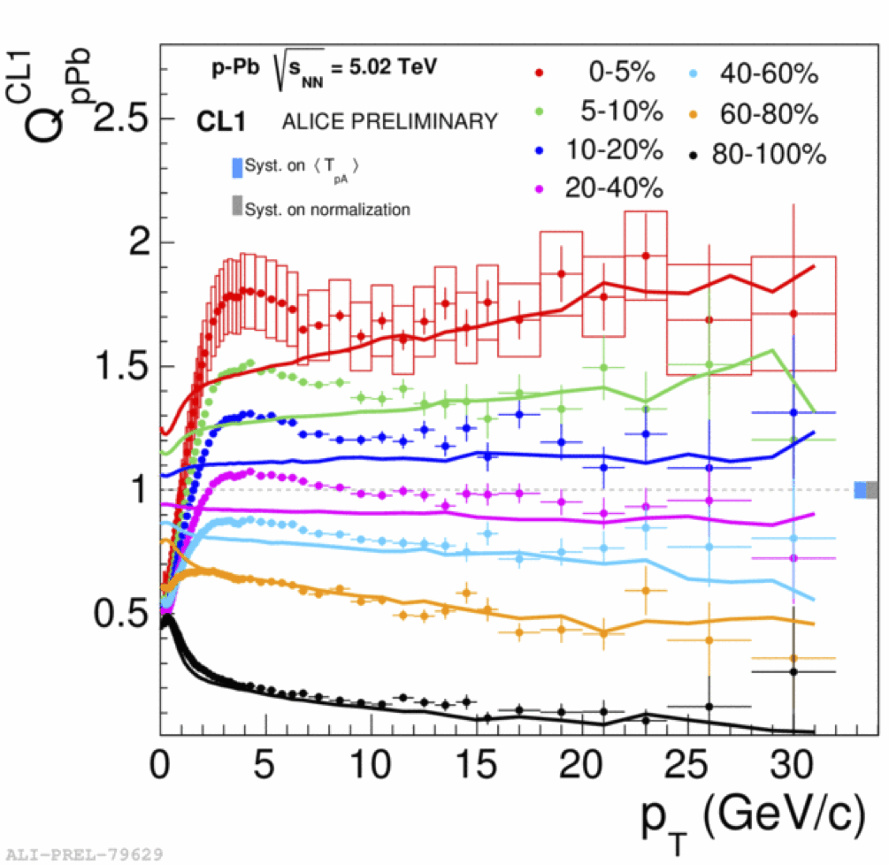
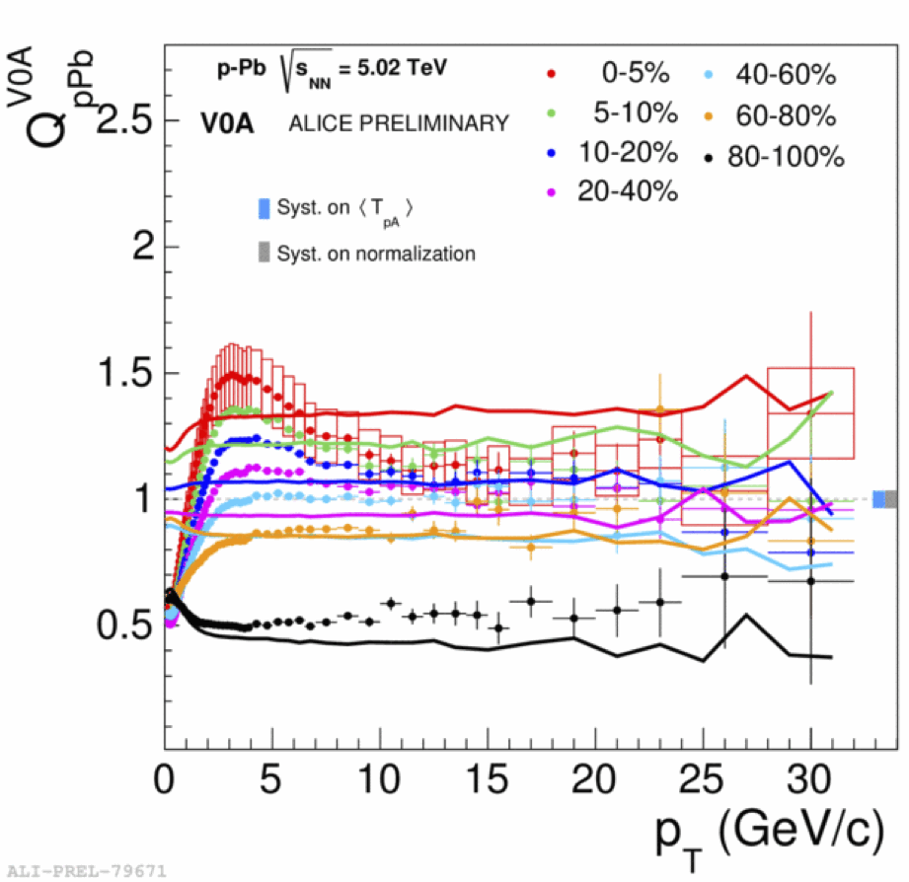
The result depends on η-region
of “centrality estimator” in pA
Multiplicity fluctuations
Jet-veto bias
Geometric bias
Alberica Toia,
19/May, Initial state

Slide 16
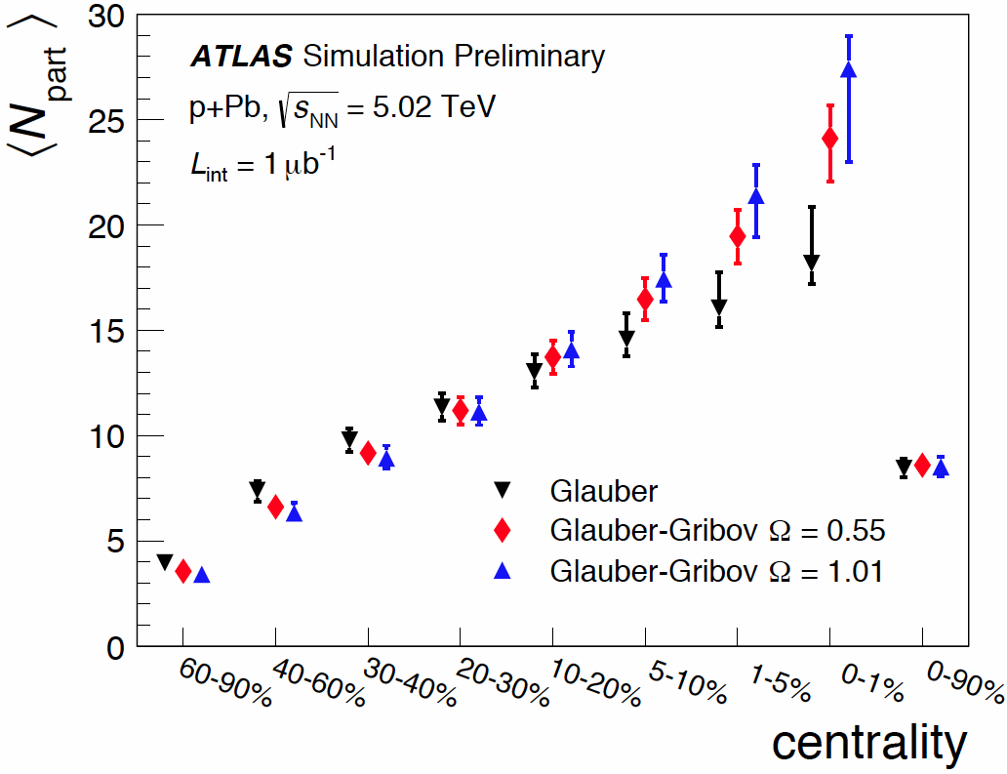
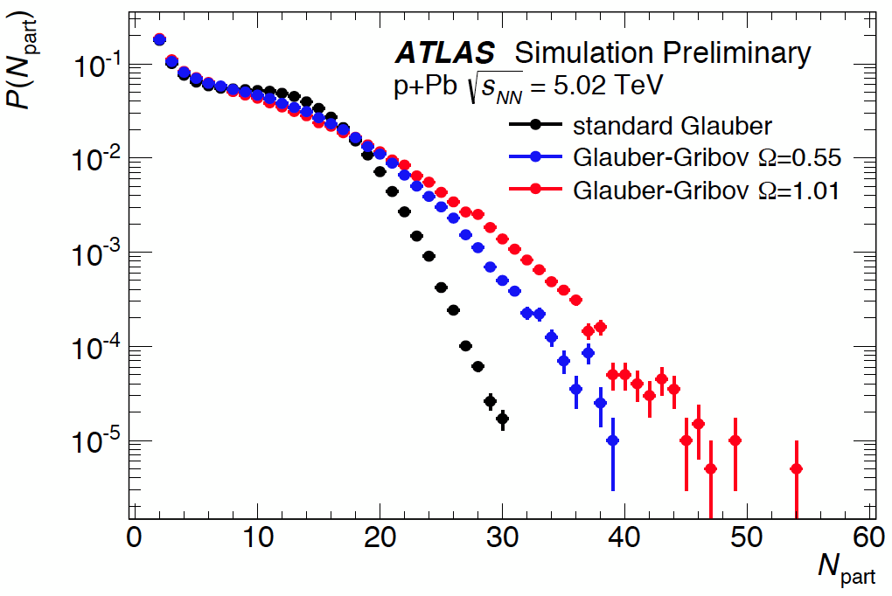
Glauber options for mapping centrality to N_{part}, N_{coll} in pA (ATLAS)
Glauber-Gribov
- color fluctuation (Ω)

Slide 17
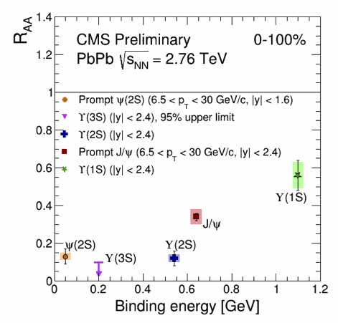
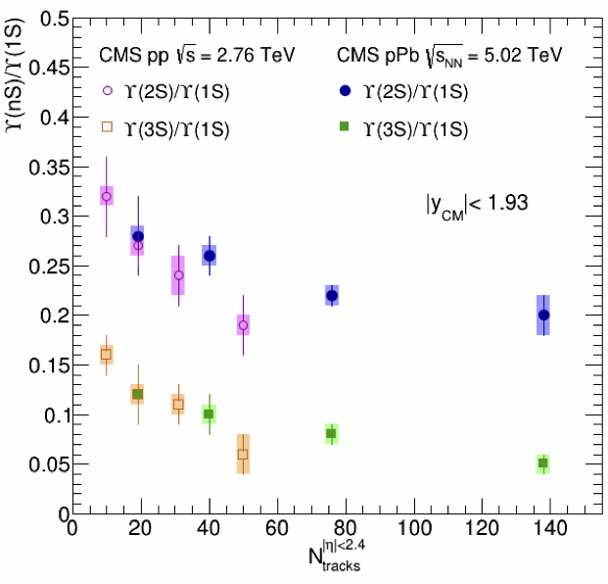
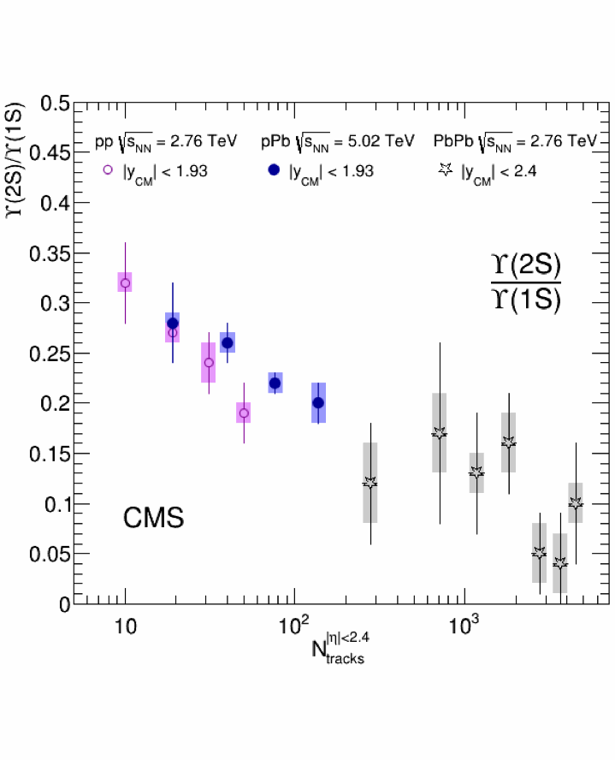
Upsilon in pp and pPb vs multiplcity
Large dependence with mult.^{central}
smaller dependence with E_{T}^{forward}
Abdulla Abdulsalam,
21/May, open heavy flavor

Slide 18
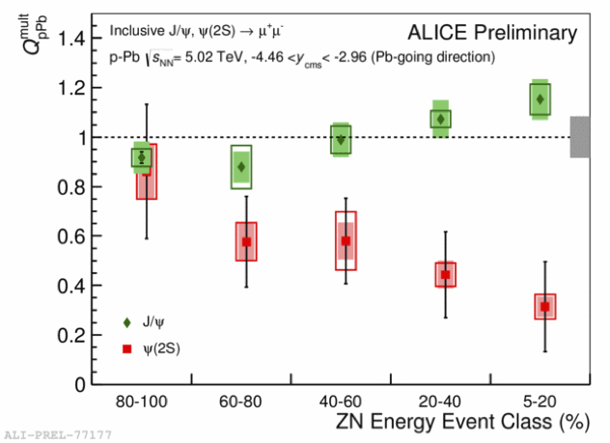
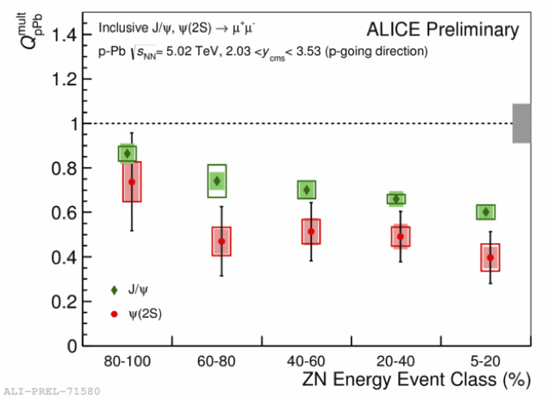
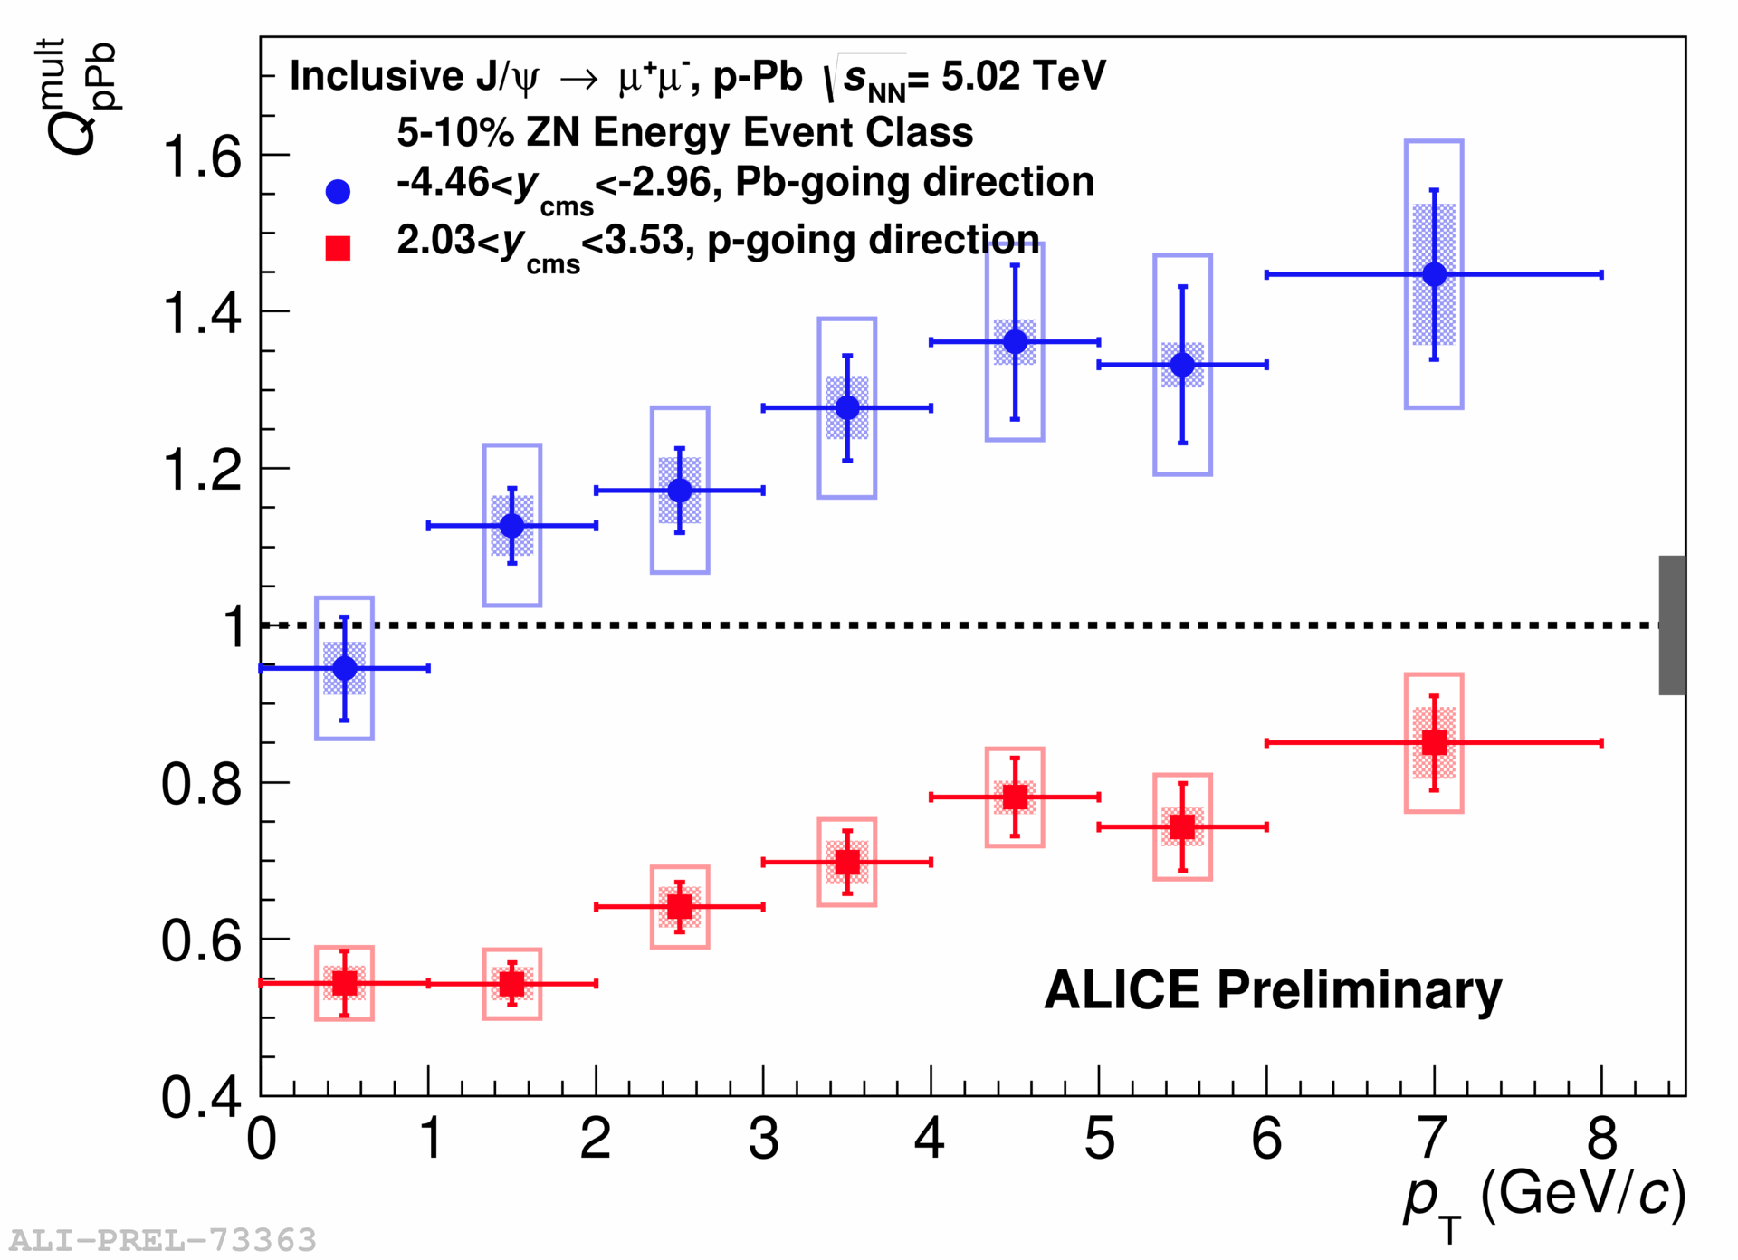
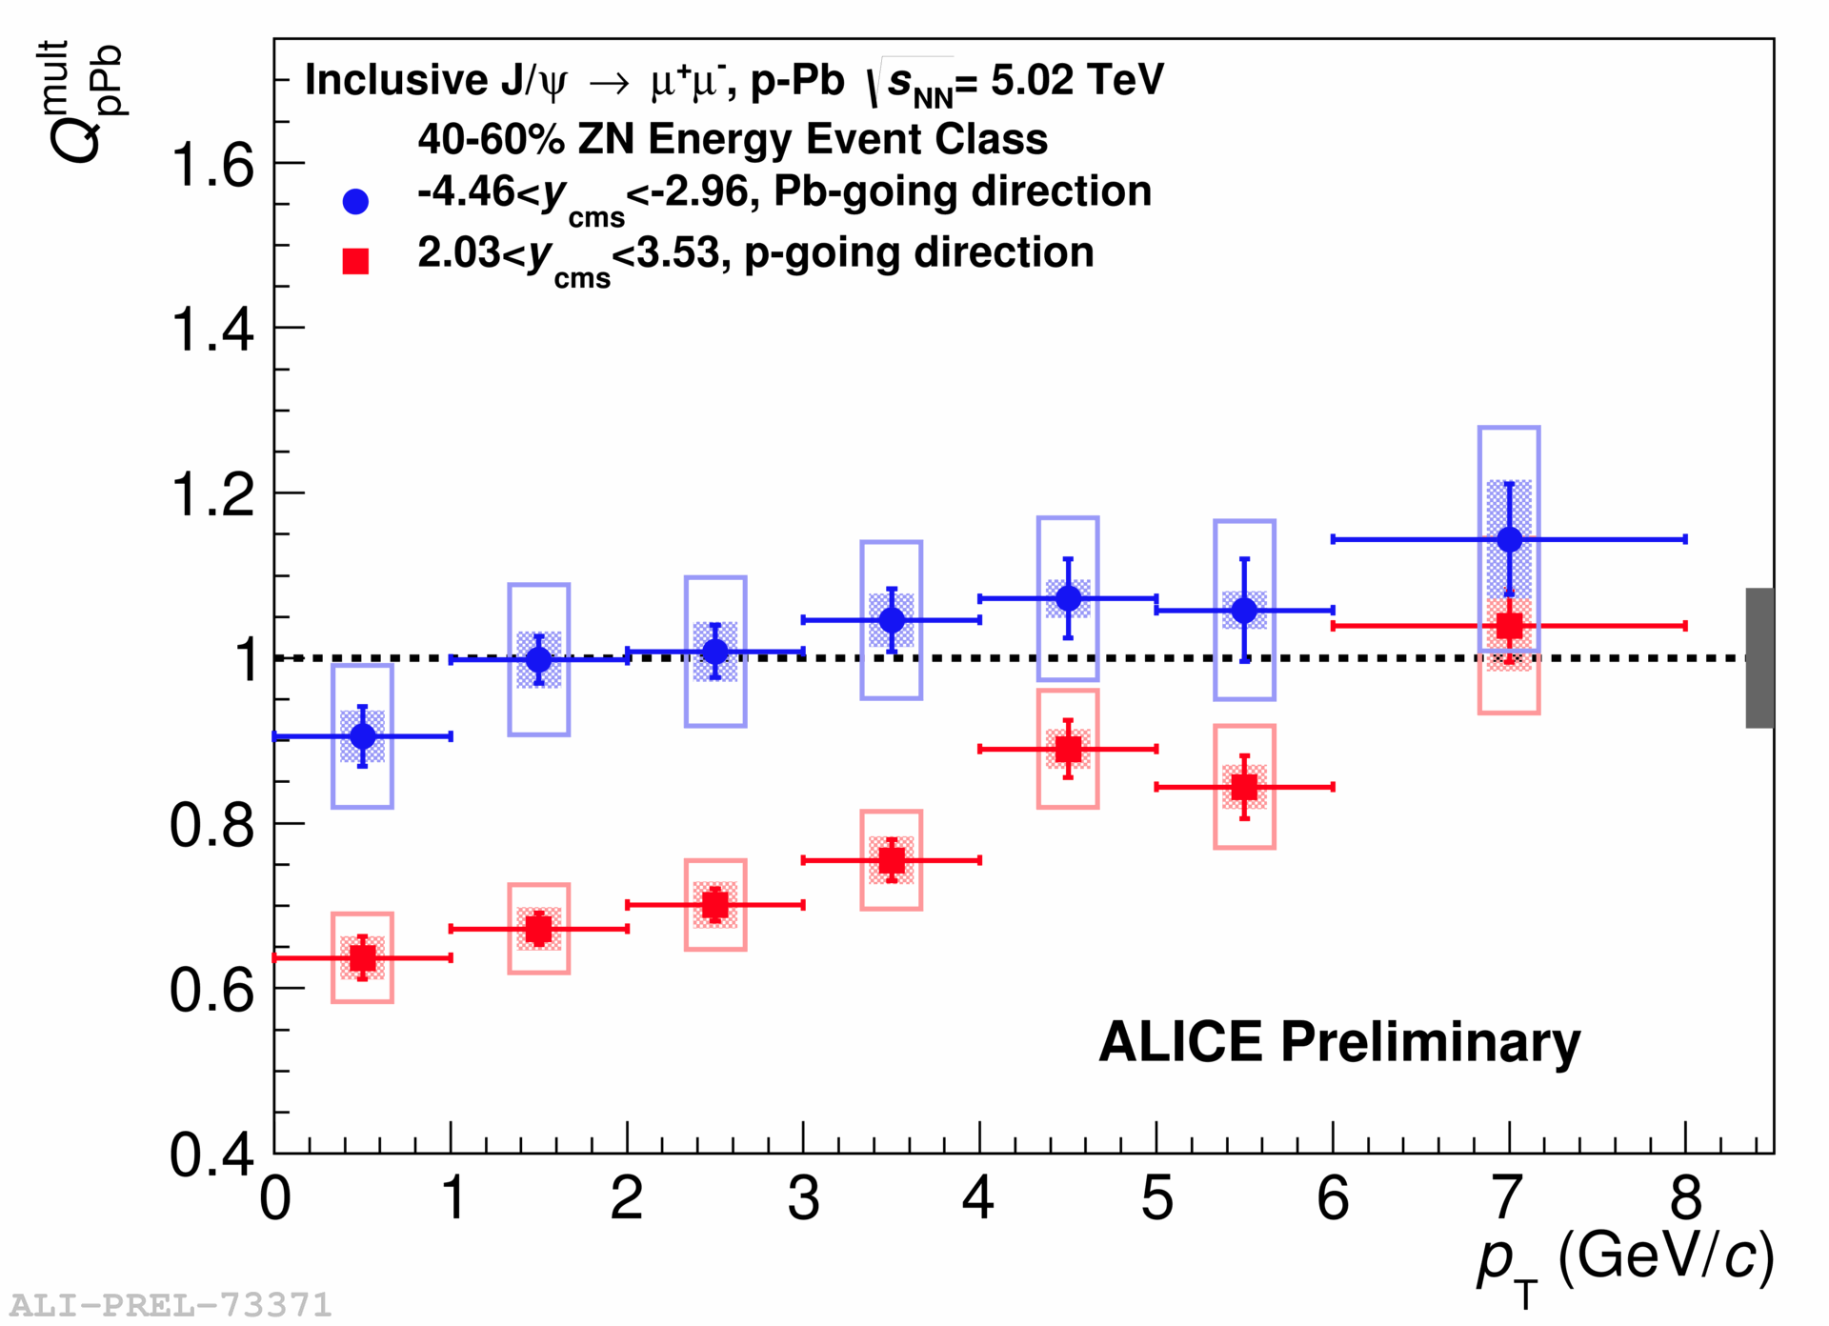
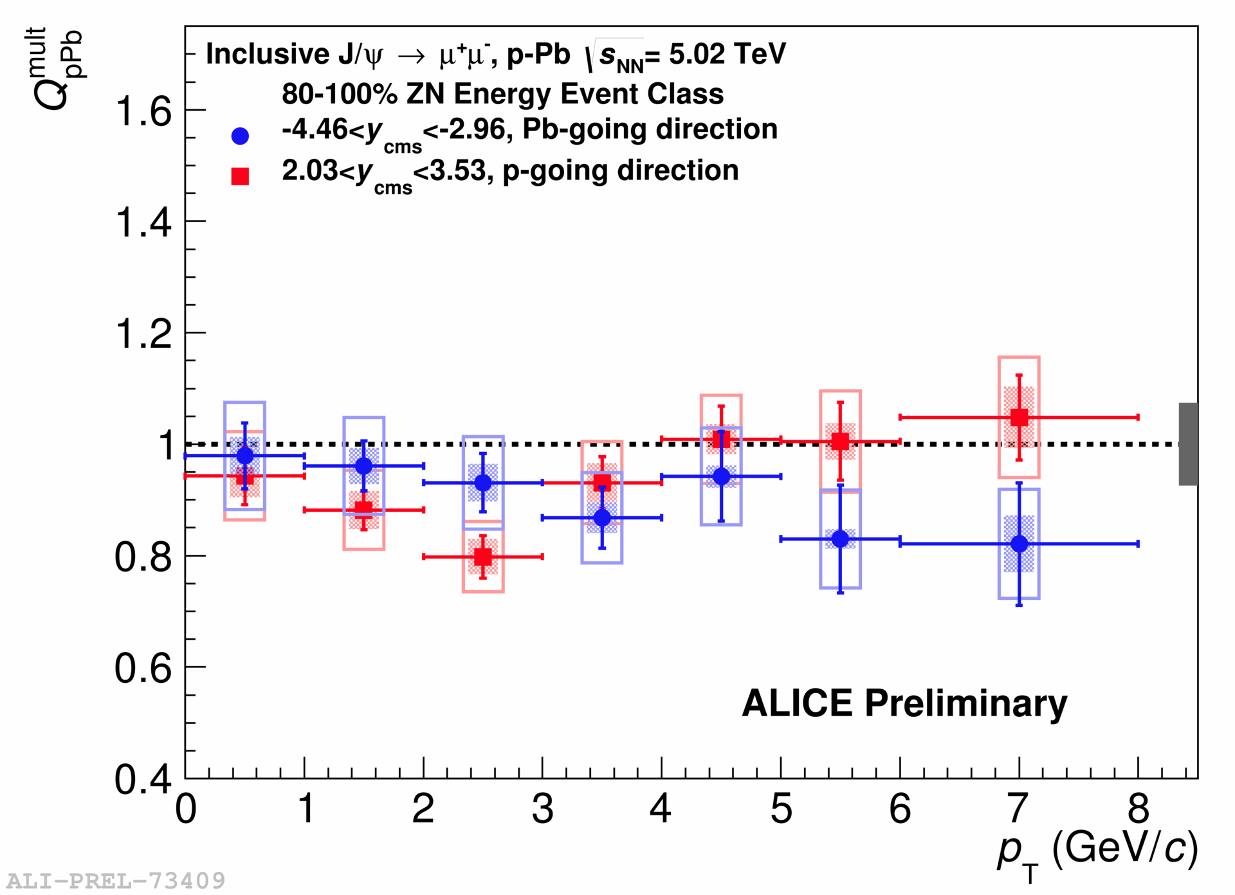
Charmonia Q_{pA}
Backward (Pb-going)
Forward (p-going)
J/ψ
J/ψ
Ψ(2S)
Ψ(2S)
Centrality
Backward (Pb-going) J/ψ
Forward (p-going) J/ψ
Javier Martin Blanco, Roberta Arnaldi,
20/May, open heavy flavor

Slide 19
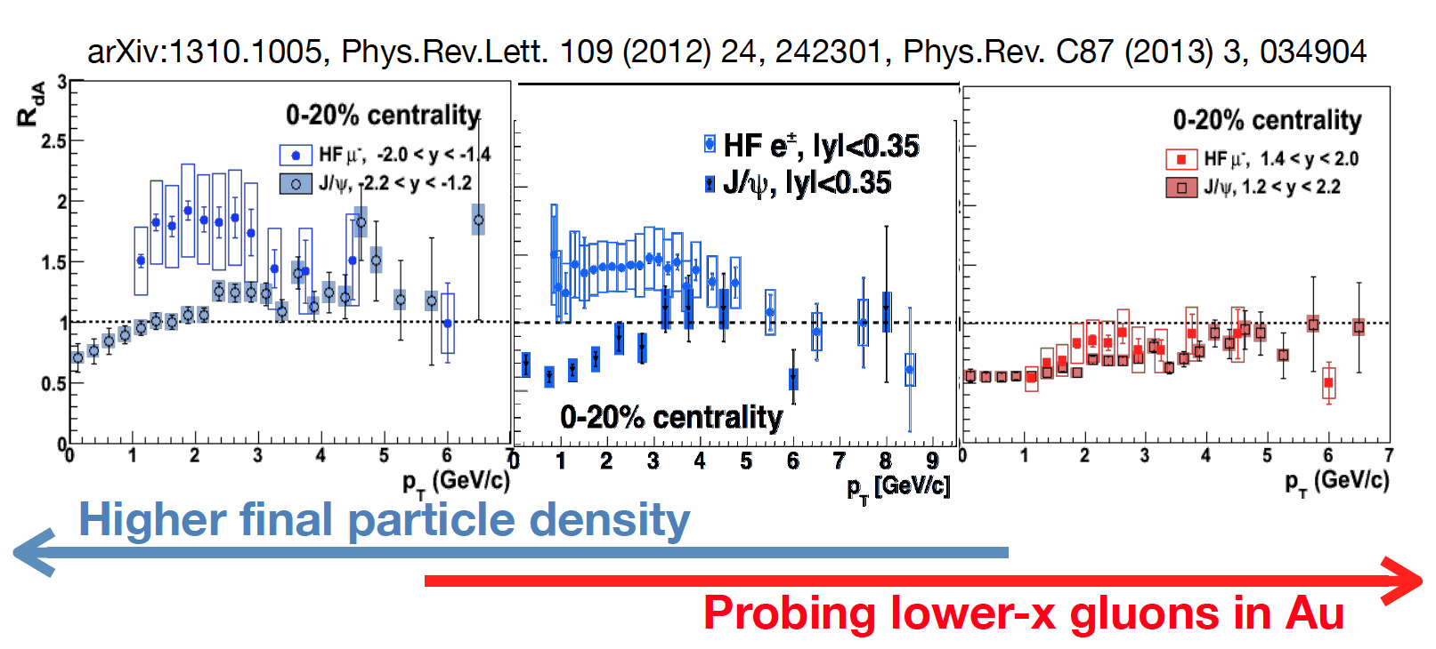
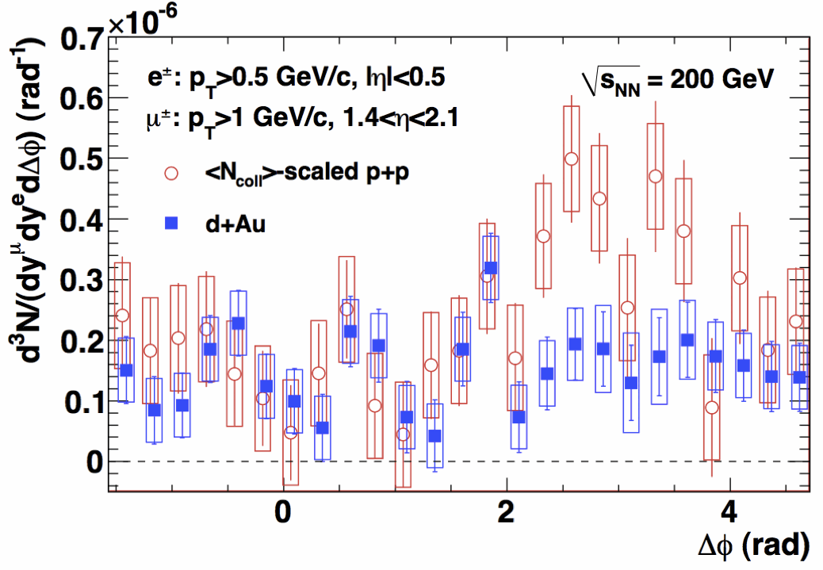
backward
Au-going
central
Forward
d-going
open charm
hidden charm
Xiaochun He, 22/May
Heavy Flavor and J/psi in dAu
away-side suppression in dAu for
central e - forward μ correlation
Alan Dion,
19/May, heavy Flavor

Slide 20
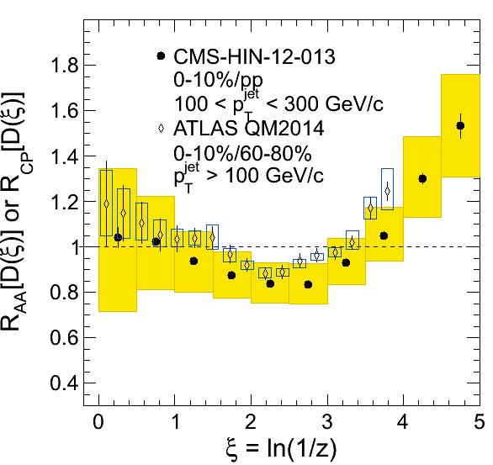
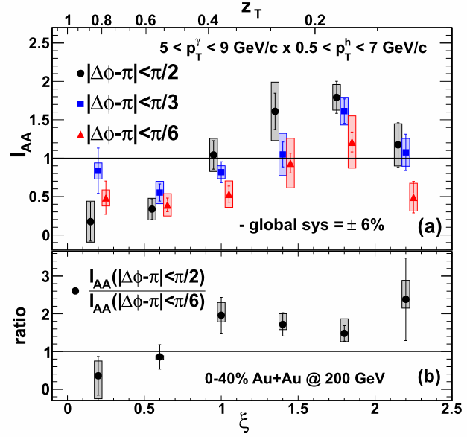
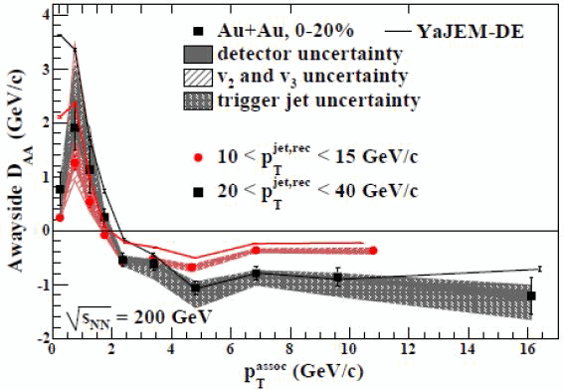
Jet quenching and
re-distribution of the lost-energy
in A+A at LHC and RHIC
Yen-Jie Lee , 23/May
Joern Putschke,
21/May, Jets
PRL 111, 032301 (2013)

Slide 21
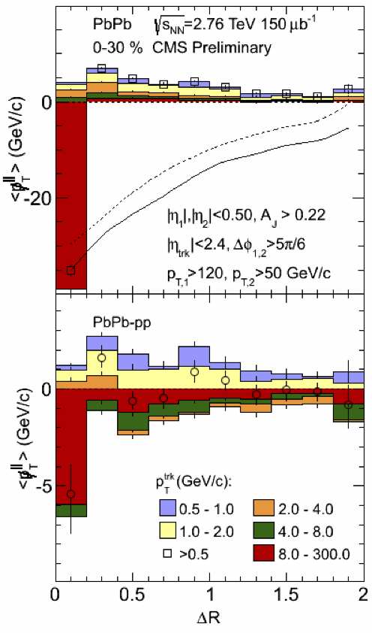
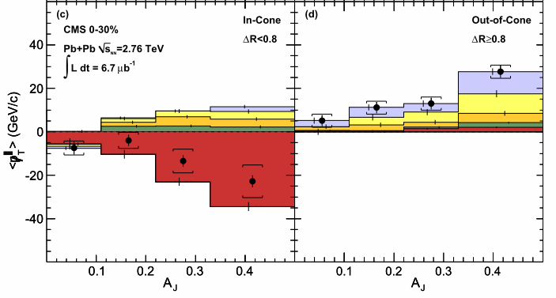
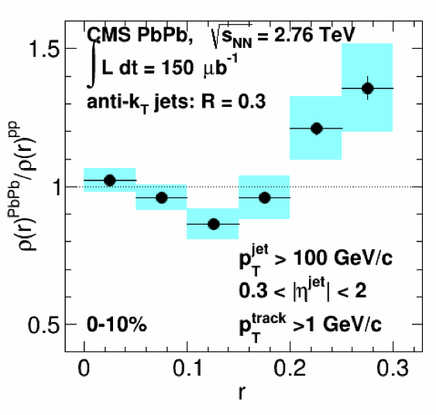
Detailed (ΔR,p_{T}) distributions
of the lost energy
at LHC
Doga Gulhan,
21/May, jets

Slide 22
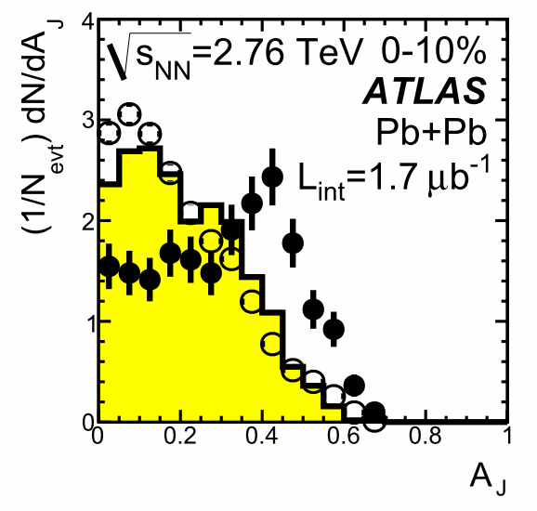
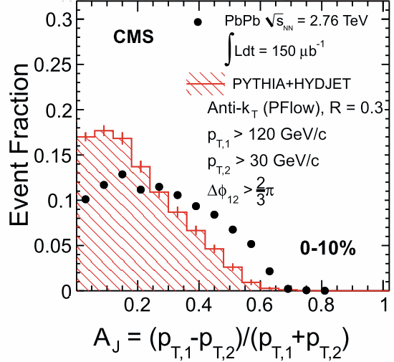
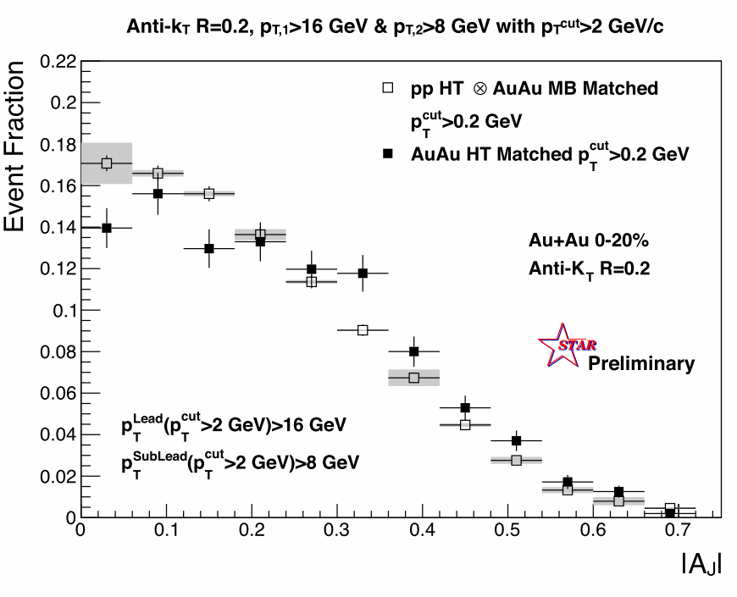
Jet quenching at RHIC
(A_{J} distribution)
lower jet energy than LHC
smaller effect than LHC
larger effect with smaller jet cone
visible modification from pp
Joern Putschke,
21/May, Jets

Slide 23
Event Shape Engineering
by Flow-Vector
Q₂ selection
ε₂^{initial} – v₂ – ε₂^{final}
Soumya Mohapatra,
20/May, collective
ShinIchi Esumi,
21/May, cor./flu.

Slide 24
v₂^{(Low pT)} – v₂^{(high pT)}
correlation
v₂– v₃
correlation
Soumya Mohapatra,
20/May, collective

Slide 25
p_{T} dependent
flow fluctuation
amazing similarity
in hydro-models
especially at mid-pT
and in central…
Damir Devetak,
20/May, collective
You Zhou,
20/May, collective

Slide 26
Direct (thermal) photon v₂ and v₃
Sanshiro Mizuno,
19/May, ele./mag.
flatter p_{T} dependence of v₂ at low p_{T}
Non-zero v₃ for low p_{T} thermal photon

Slide 27
R_{gamma} comparison
between RHIC and LHC
Friederike Bock,
19/May, ele./mag.
PHENIX arXiv:1405.3940
Sanshiro Mizuno,
19/May, ele./mag.

Slide 28
Beam energy dependence
of net-proton, net-charge distribution
Nu Xu, 22/May

Slide 29
Beam energy dependence
of v₁ and v₂
PRL112, 162301(2014), arXiv:1401.3043
Nu Xu, 22/May

Slide 30
Beam energy dependence
of charge asymmetry, HBT, v₂
arXiv:1404.1433
Nu Xu, 22/May
∼u_{expan.}
∼Δτ
PRL 112, 082302 (2014)
Roy Lacey,
19/May, collective

Slide 31
Summary
pPb at LHC, dAu at RHIC
HF, jet, flow and fluctuation
energy scan

Slide 32
RHIC-PHENIX --- R_{dAu} of π⁰ and jet ---

Slide 33
Disentangling the lower order contribution on v_{n}
Soumya Mohapatra,
20/May, collective

Slide 36
M_{ee}^{inv.} spectra and Direct γ^{thermal}
Chi Yang,
19/May, ele./mag.
Patrick Huck,
19/May, ele./mag.

