Slide 1
エネルギー走査実験と
バリオン数ゆらぎ
北沢正清
(Osaka U.)
Heavy Ion Pub, 2011/12/16, Osaka U.

Slide 2
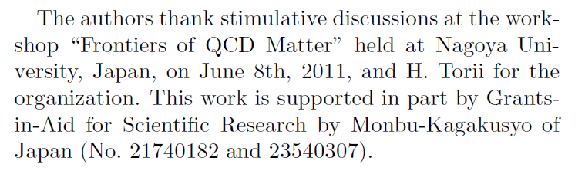
Outline
ゆらぎを用いたQCD相構造の探索
バリオンおよび陽子数ゆらぎの関係について
MK, Asakawa, arXiv:1107.2755

Slide 3
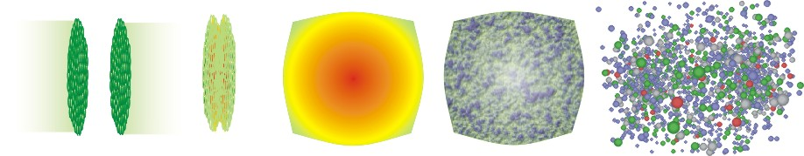
Energy Scan Program @ RHIC
high
beam energy
T
low
Hadrons
Color SC
0
μ

Slide 4
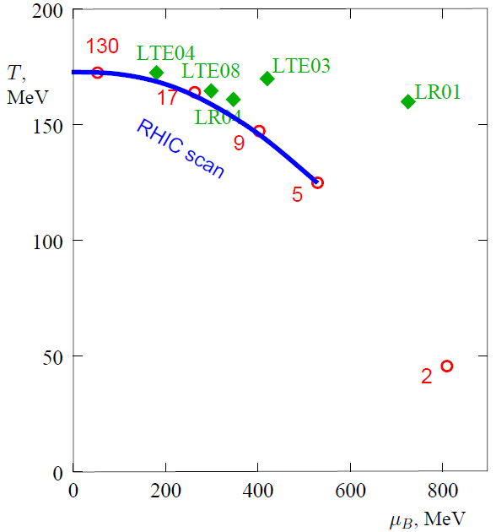
Energy Scan Program @ RHIC
high
beam energy
T
low
Hadrons
Color SC
0
μ

Slide 5
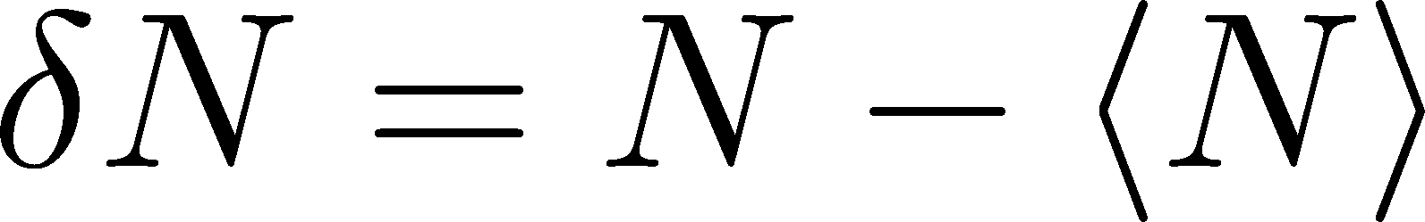
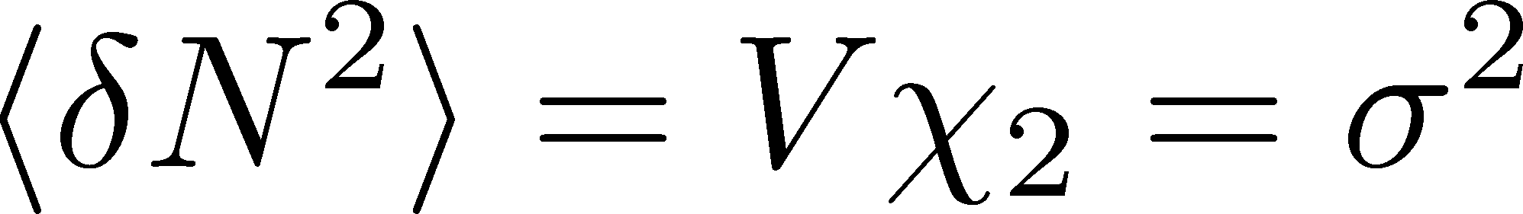

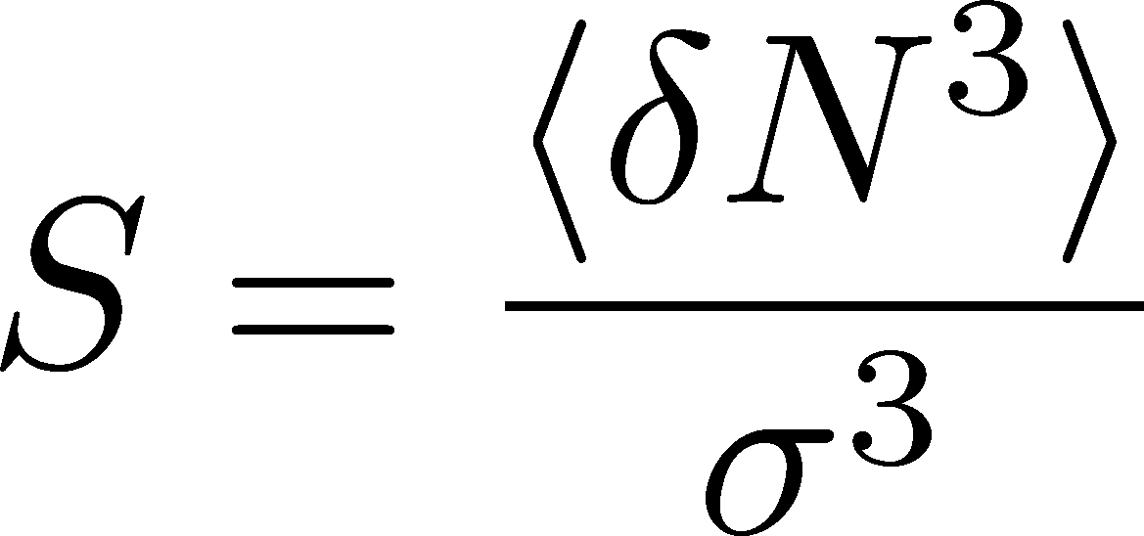
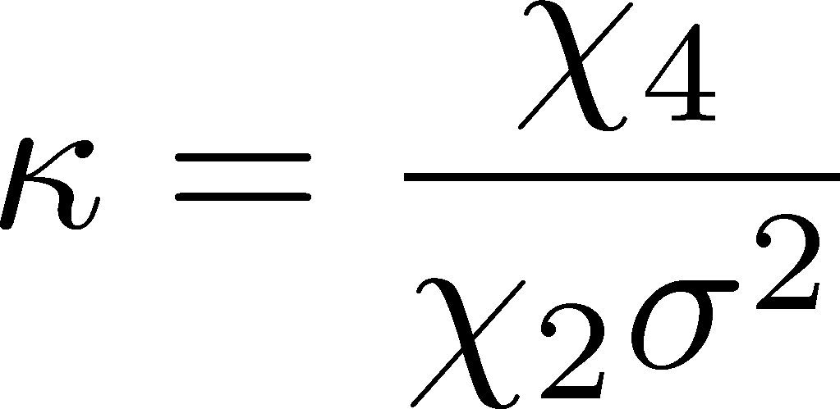
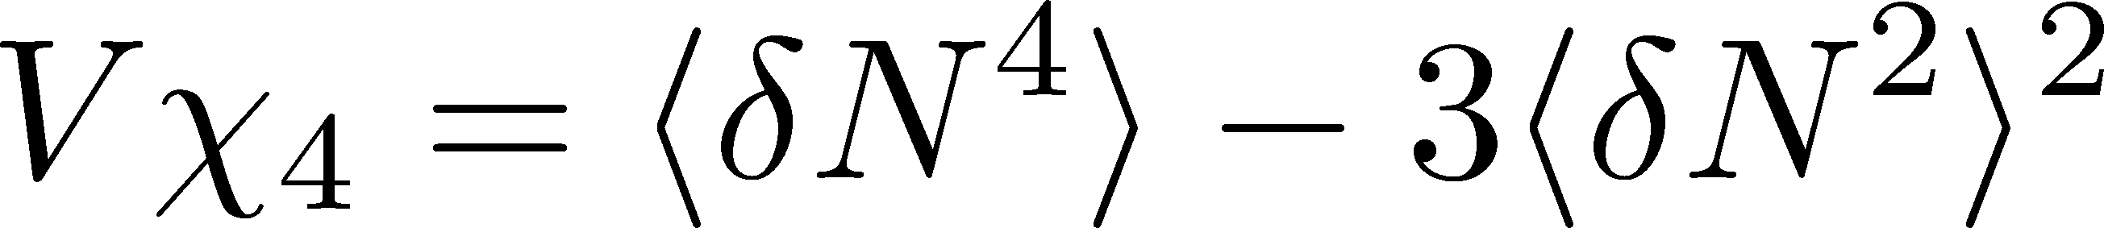
Fluctuations
P(N)
平衡状態において、
物理量はゆらいでいる。
N
V
N
ゆらぎを特徴づける量
Variance:
Skewness:
N
Kurtosis:
And much higher…

Slide 6
Event-by-Event Analysis @ HIC
Fluctuations can be measured by e-by-e analysis in experiments.
V
Detector
Variation of N_{Q} in a rapidity range is small for conserved charges.
Asakawa, et al., ’00; Jeon, Koch, ’00; Shuryak, Stephanov, ’02

Slide 7
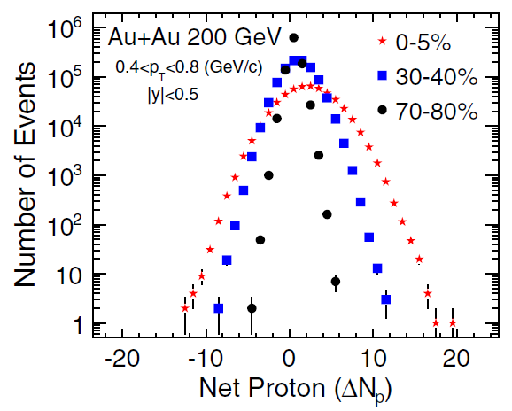
Event-by-Event Analysis @ HIC
Fluctuations can be measured by e-by-e analysis in experiments.
STAR, PRL105 (2010)
Detector
Variation of N_{Q} in a rapidity range is small for conserved charges.
Asakawa, et al., ’00; Jeon, Koch, ’00; Shuryak, Stephanov, ’02

Slide 8




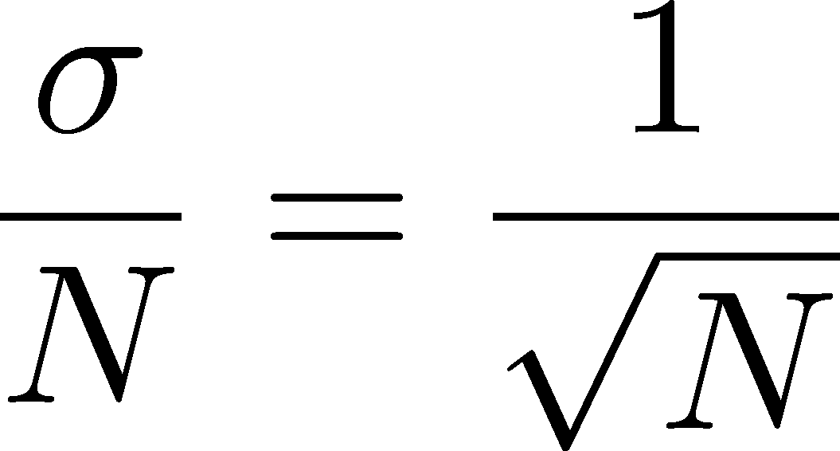



イジング模型とゆらぎ
N個のスピン

Slide 9

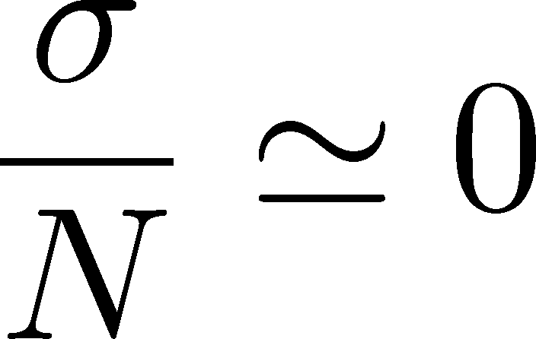
イジング模型とゆらぎ
N個のスピン

Slide 10

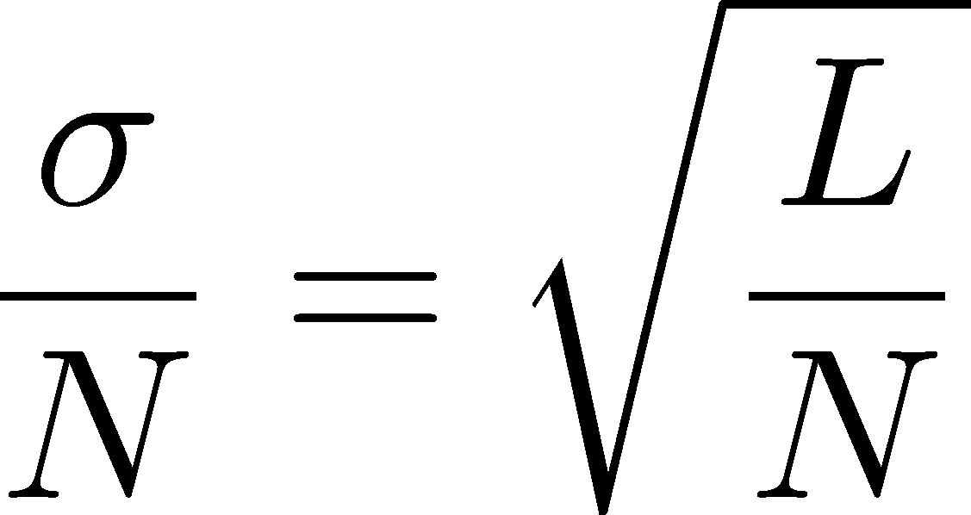
イジング模型とゆらぎ
N個のスピン
N/L個の独立な
スピンの集団
長さLで大体同じ向き
ゆらぎはL^{d/2}で増大し、
臨界点で発散する。

Slide 11
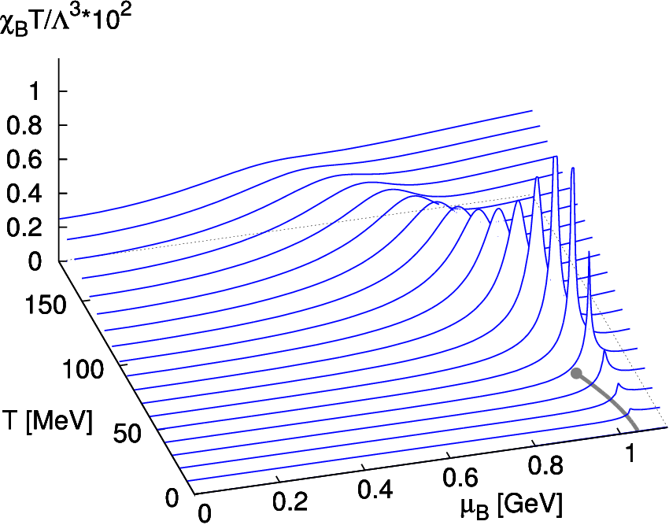
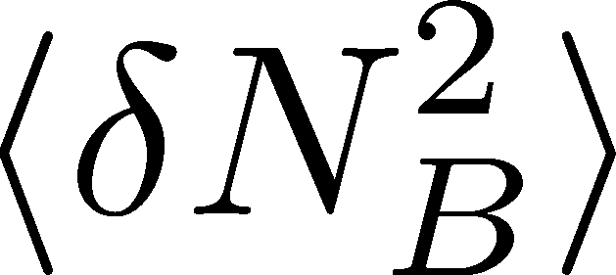
Fluctuations at QCD Critical Point
Stephanov, Rajagopal, Shuryak ’98,’99
2nd order phase transition at the CP.
divergences in fluctuations of
p_{T} distribution
freezeout T
baryon number, chage, …

Slide 12
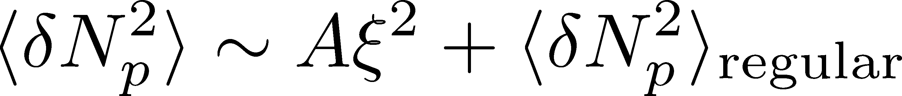
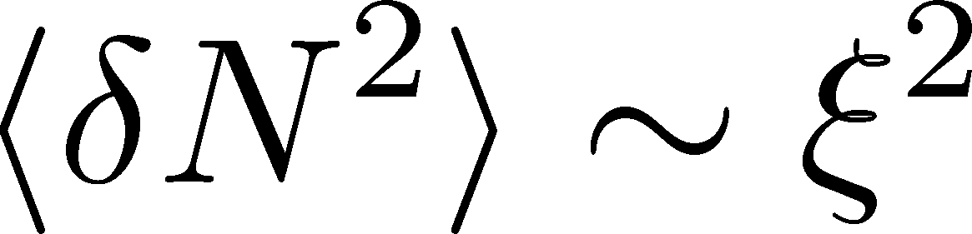
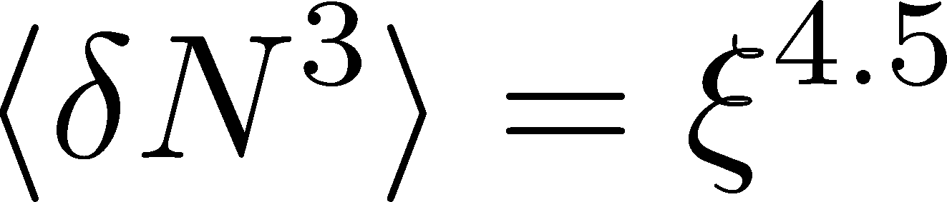
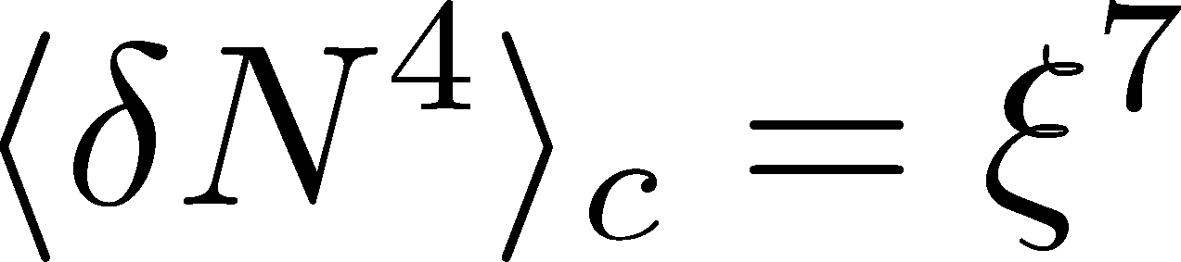
Fluctuations at QCD Critical Point
Stephanov, Rajagopal, Shuryak ’98,’99
2nd order phase transition at the CP.
divergences in fluctuations of
p_{T} distribution
freezeout T
baryon number, chage, …
Singular part in proton number fluctuations.
Hatta, Stephanov, ’02
Higher order moments has stronger ξ dep near the CP.
Stephanov, ’09

Slide 13

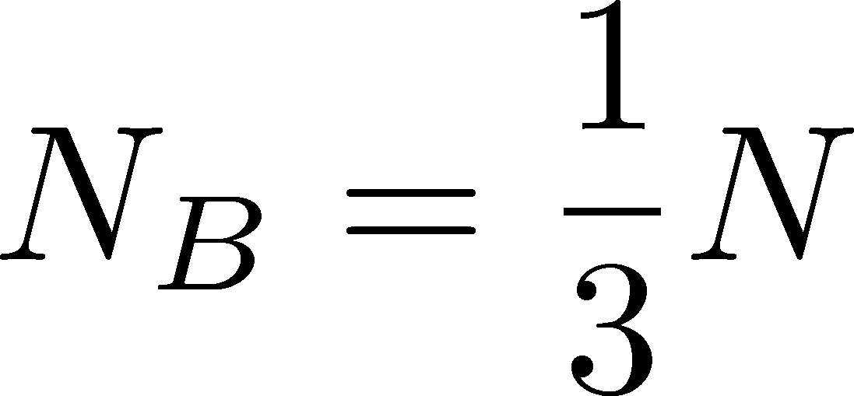

準粒子の素電荷とゆらぎ
Boltzmann gas
(=Poisson distribution)
Hadrons:
Quark-gluon:
p
p
n
n
n
p

Slide 14
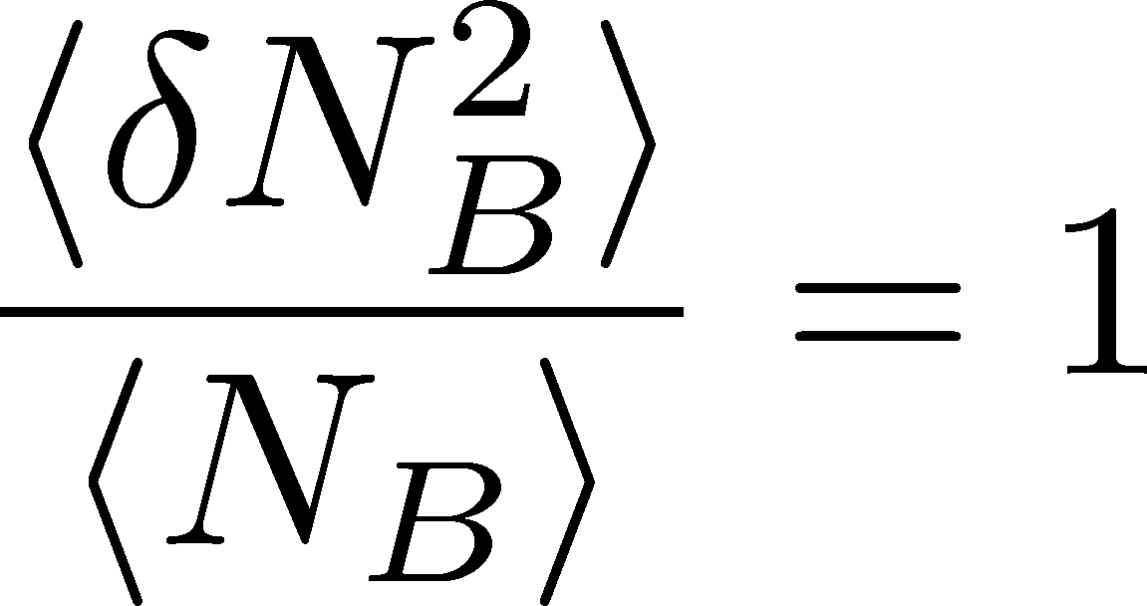
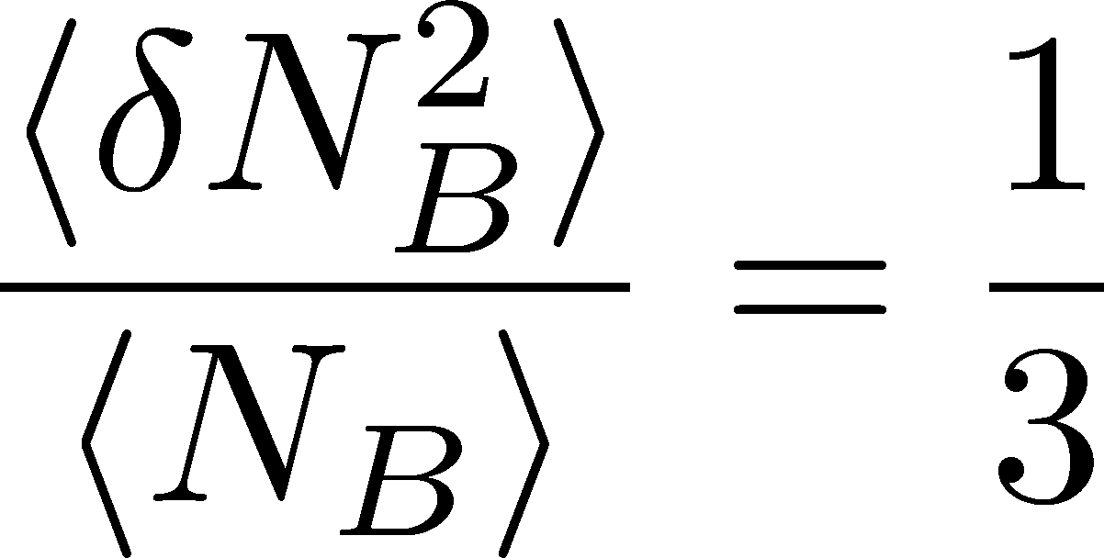
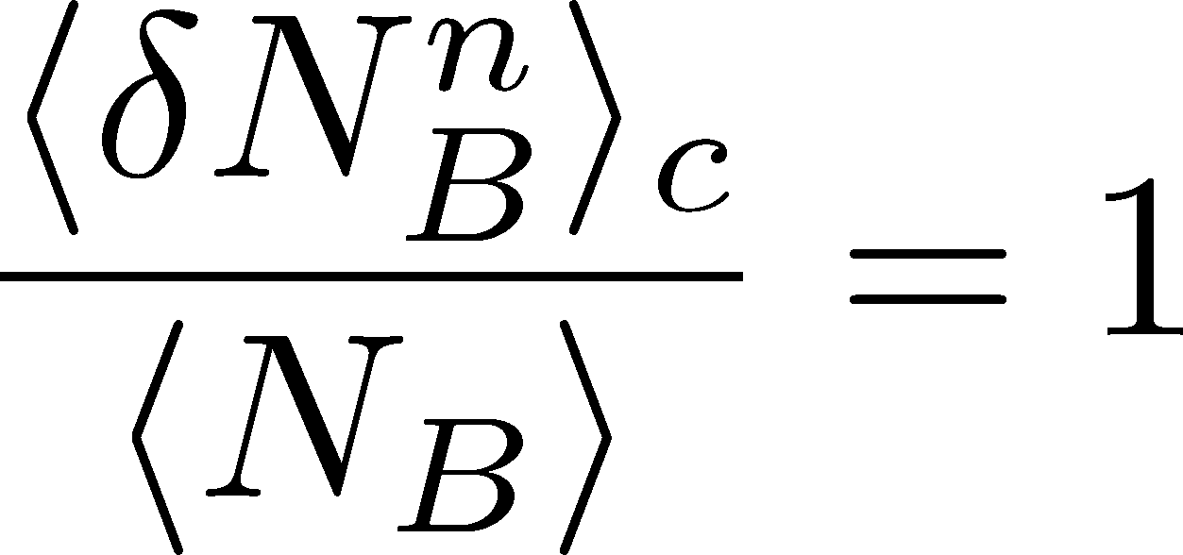
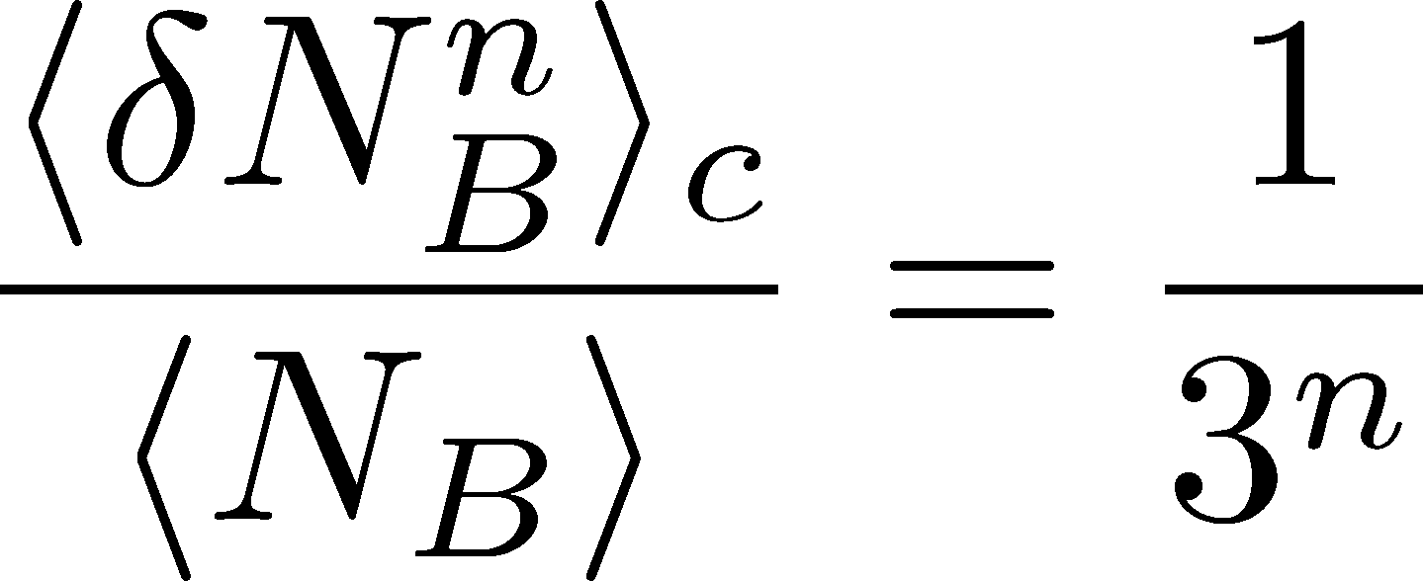
準粒子の素電荷とゆらぎ
Asakawa, Heinz, Muller, ’00
Jeon, Koch, ’00
Ejiri, Karsch, Redlich, ’06
Hadrons:
Quark-gluon:
p
p
n
n
n
p

Slide 15
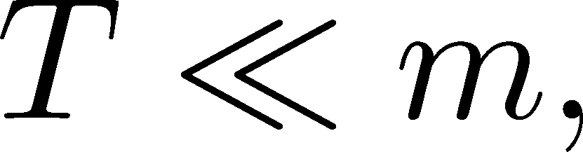
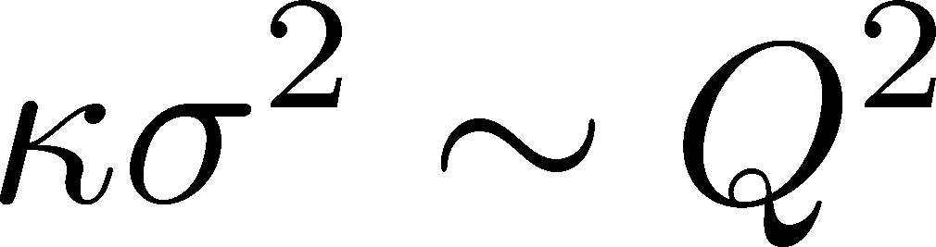
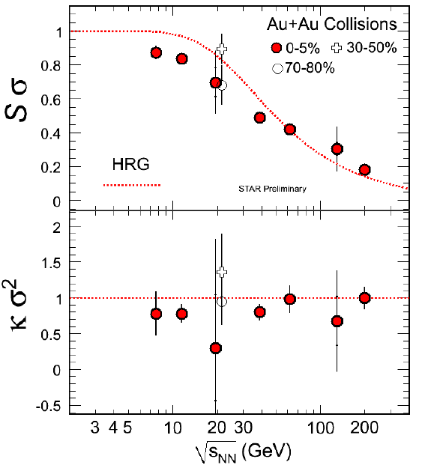
Baryon Number 4th/2nd
Ejiri, Karsch, Redlich, ’05
Ratios between higher order moments (cumulants)
RBC-Bielefeld ’09
4th/2nd at μ =0 reflects the charge of quasi-particles.
For,
Hadrons:1
Quarks:1/3²
実験結果： c4/c2~1
STAR ’10,’11

Slide 16
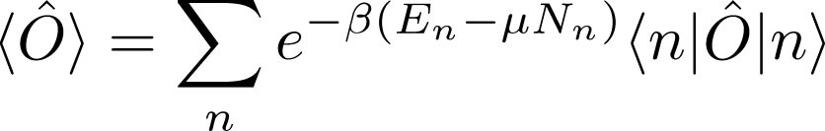
保存電荷の高次ゆらぎ 1
有限温度の期待値

Slide 17
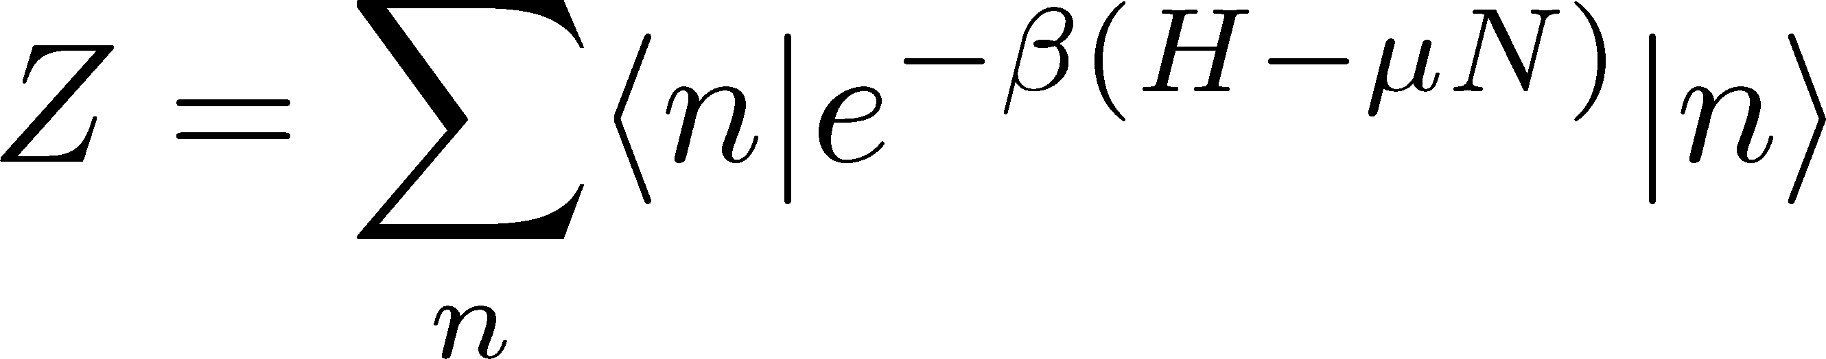
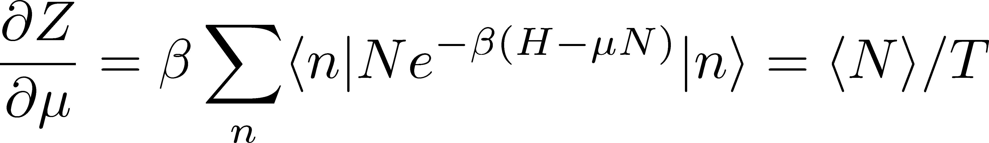
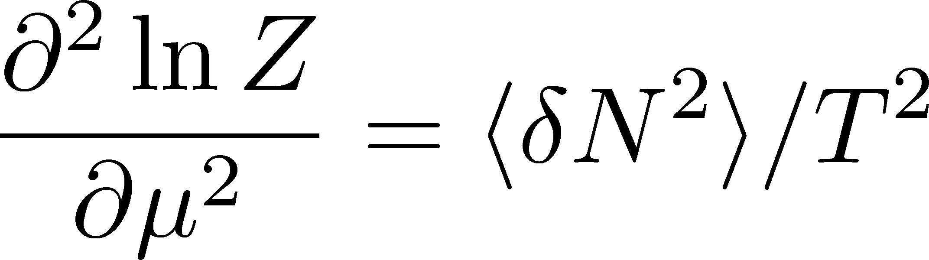
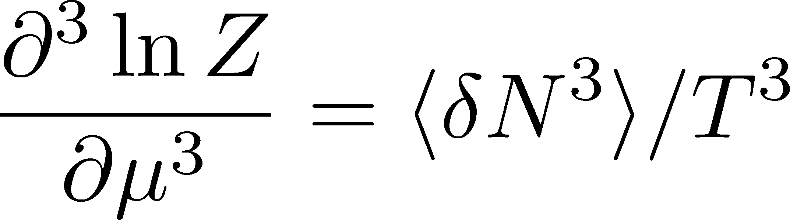
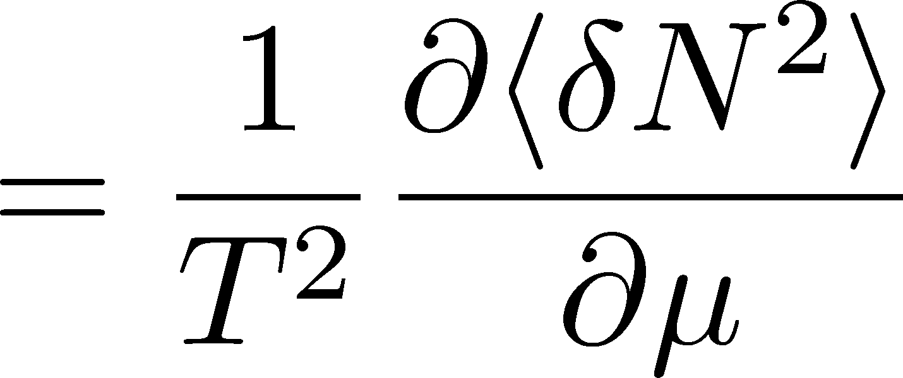
保存電荷の高次ゆらぎ 1
有限温度の期待値

Slide 18
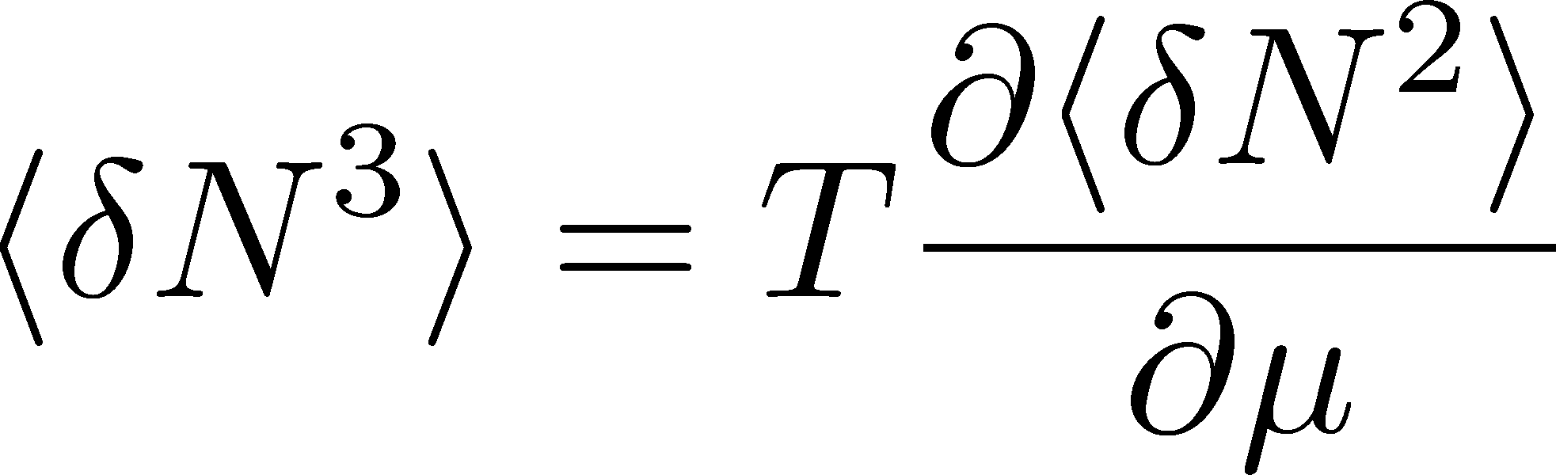

保存電荷の高次ゆらぎ 2

Slide 19
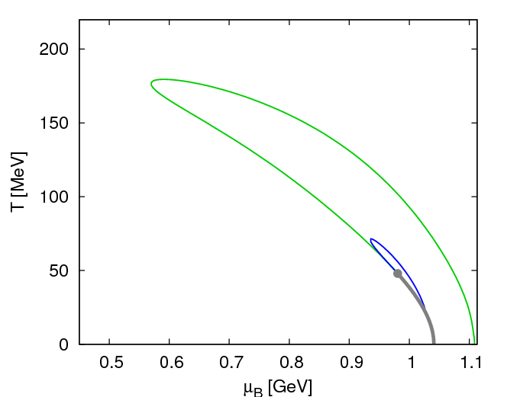
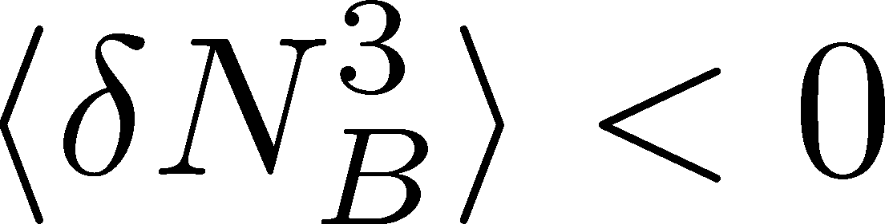
保存電荷の高次ゆらぎ 2
Asakawa, Ejiri, MK, 2009
QCD相図上でのバリオン数ゆらぎ

Slide 20
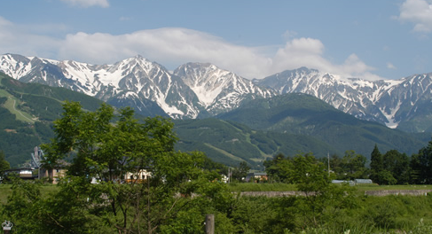
Impact of Negative Third Moments
Once negative m₃(BBB) is established, it is evidences that
(1) χ_{B} has a peak structure in the QCD phase diagram.
(2) Hot matter beyond the peak is created in the collisions.
No dependence on any specific models.
Just the sign! No normalization (such as by N_{ch}).

Slide 21
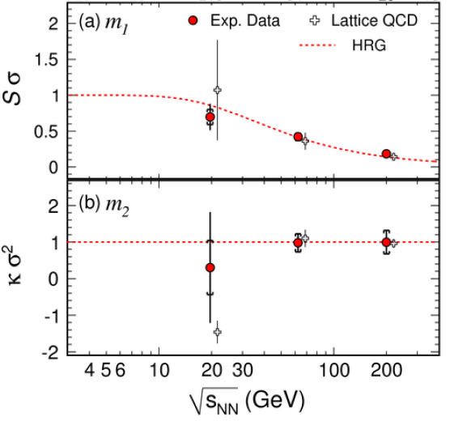
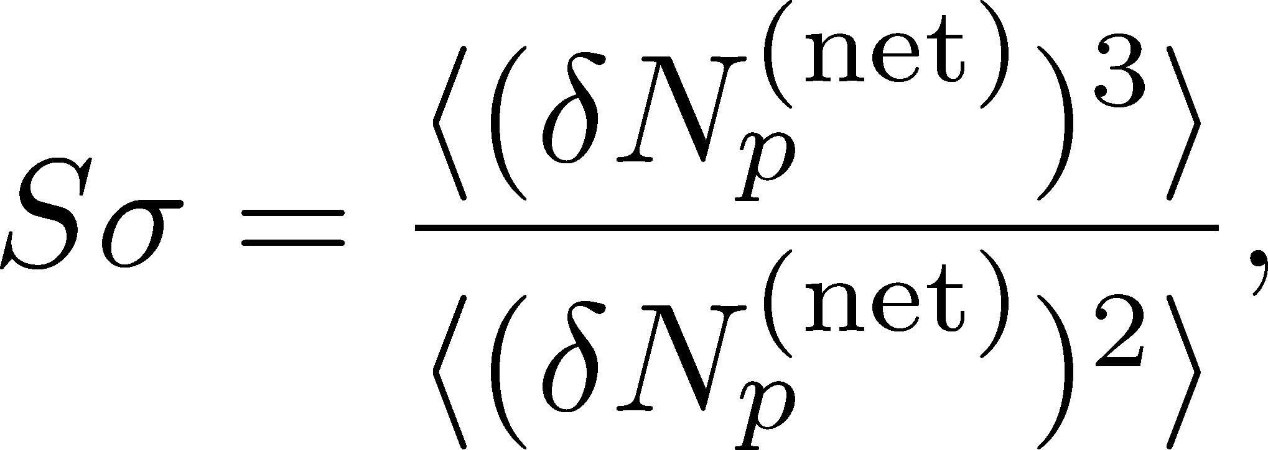
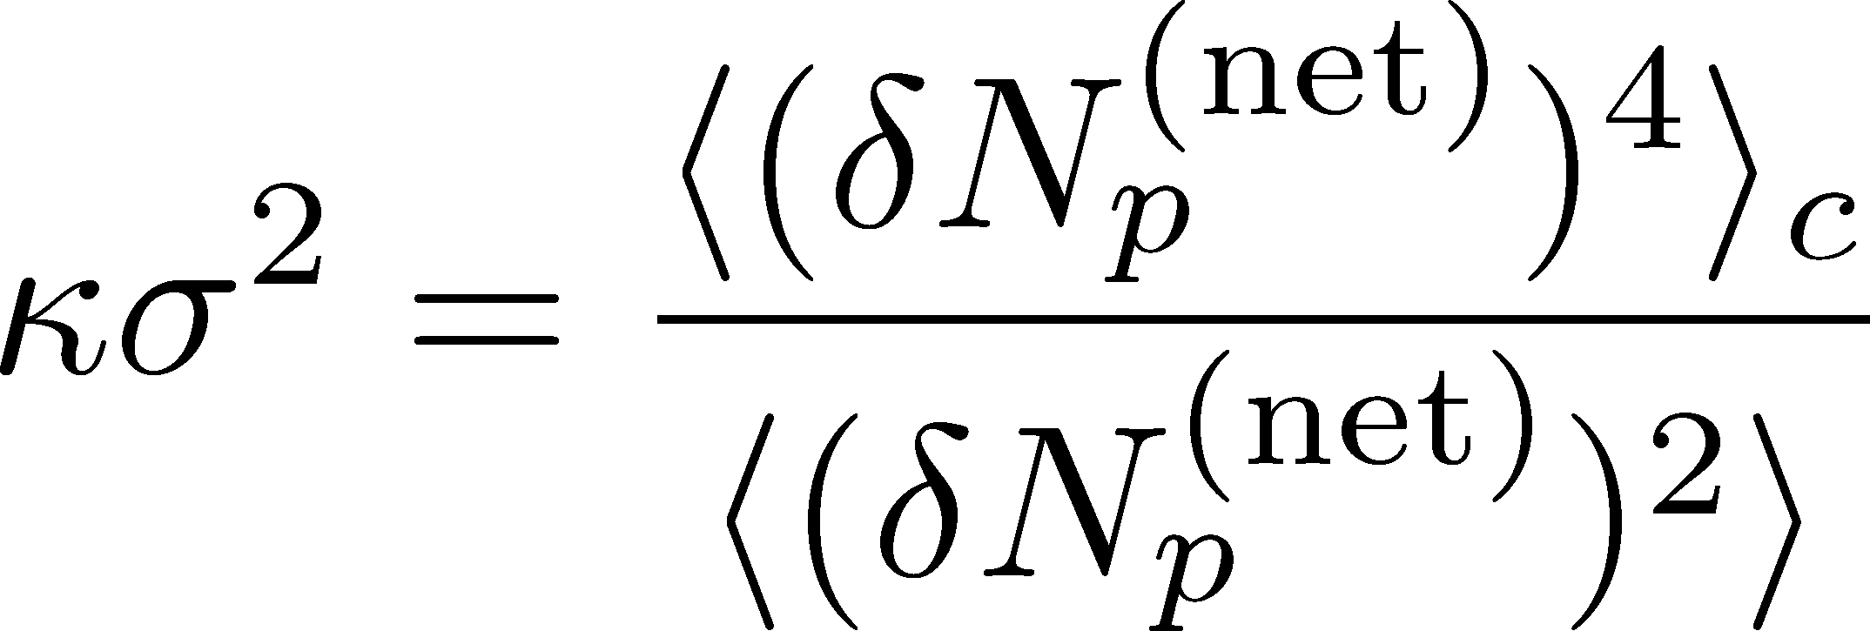
Proton # Fluctuations @ STAR
STAR, 2010

Slide 22
Proton # Fluctuations @ STAR
STAR, 2010
STAR, 2011 (Quark Matter)
high μ
low μ

Slide 23
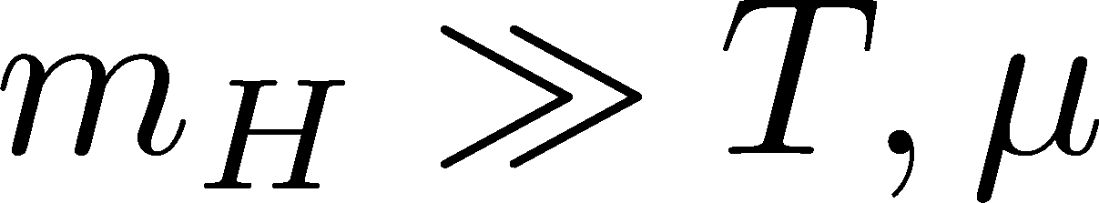
Proton # Fluctuations @ STAR
STAR, 2011 (Quark Matter)
HRG:
Hadron Resonance Gas
=
Free gas composed of
all hadrons & resonances
Poisson distribution for
hadrons since
high μ
low μ

Slide 24
観測にかかるゆらぎは、いつ形成されたのか？
ゆらぎのダイナミクス（動的振る舞い）の議論が必要
Detector

Slide 25



観測にかかるゆらぎは、いつ形成されたのか？
ゆらぎのダイナミクス（動的振る舞い）の議論が必要
保存電荷の場合
非保存電荷の場合
V
V
境界を通過する電荷
のみが変化に寄与
体積内の任意の場所で
電荷が変化できる
for
for

Slide 26
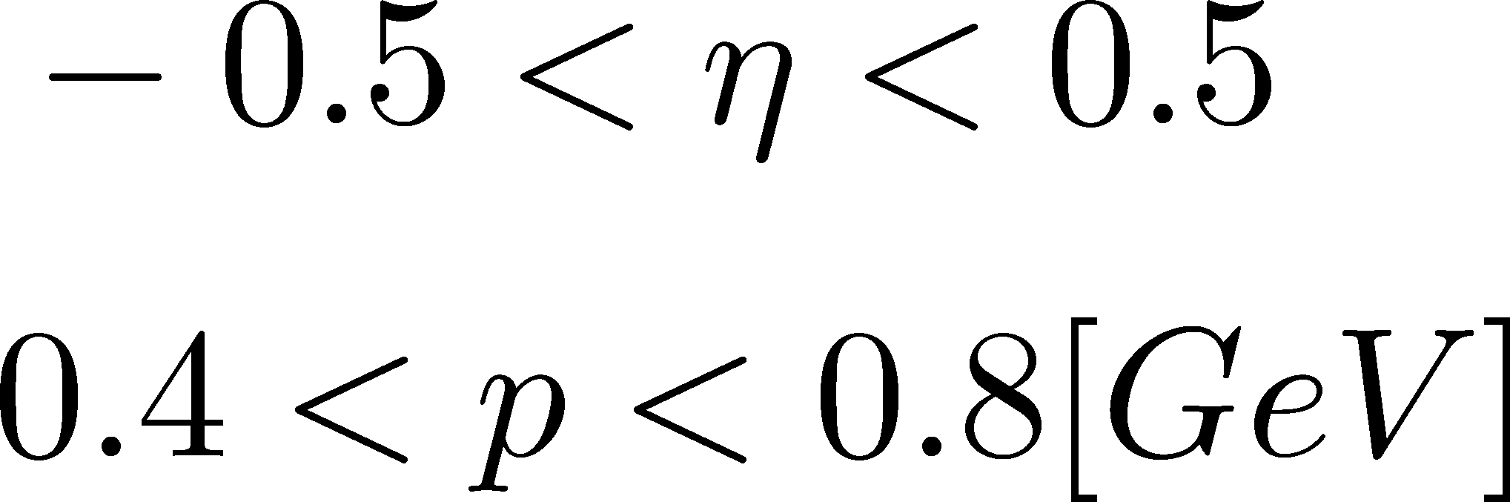
観測にかかるゆらぎは、いつ形成されたのか？
Δη内の保存電荷量は、初期段階のものが終状態まで生き残ることが期待できる。
N_{Q}
Asakawa, Heinz, Muller, ’00
Jeon, Koch, ’00
Shuryak, Stephanov, ’02
Δy
t
Note:
Δy
ＳＴＡＲ
z

Slide 27
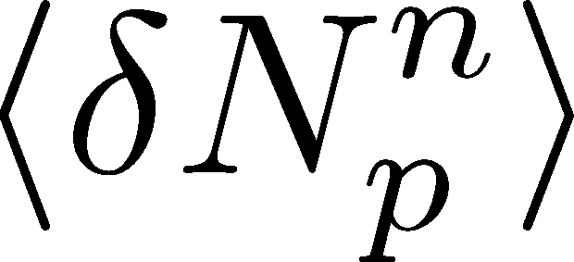
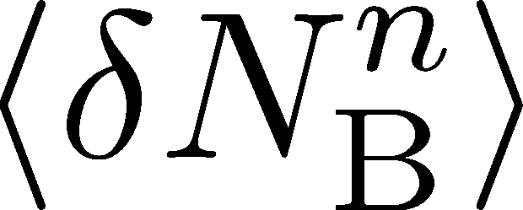
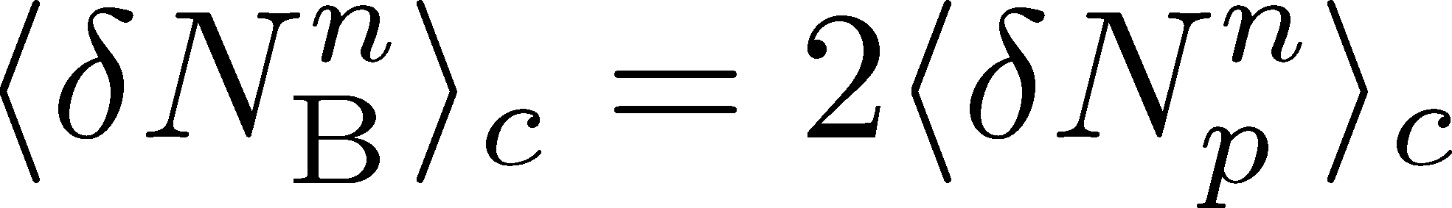
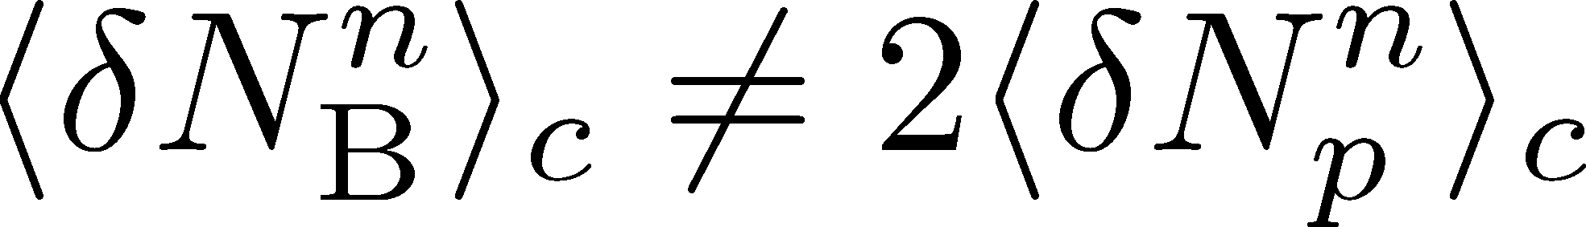
?
In equilibrated free nucleon gas,
If the medium is not equilibrated,

Slide 28
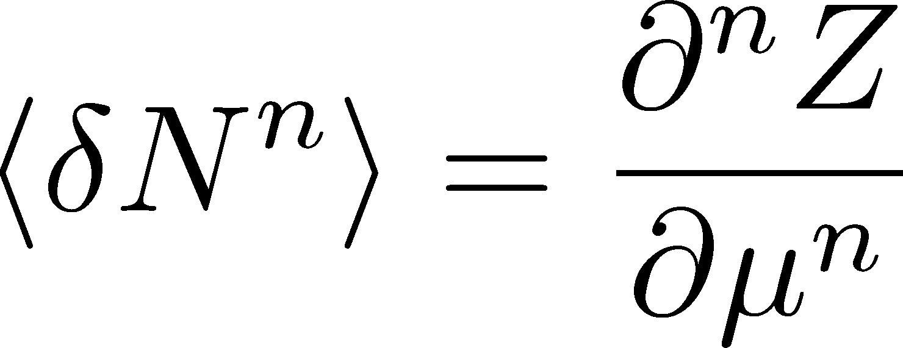
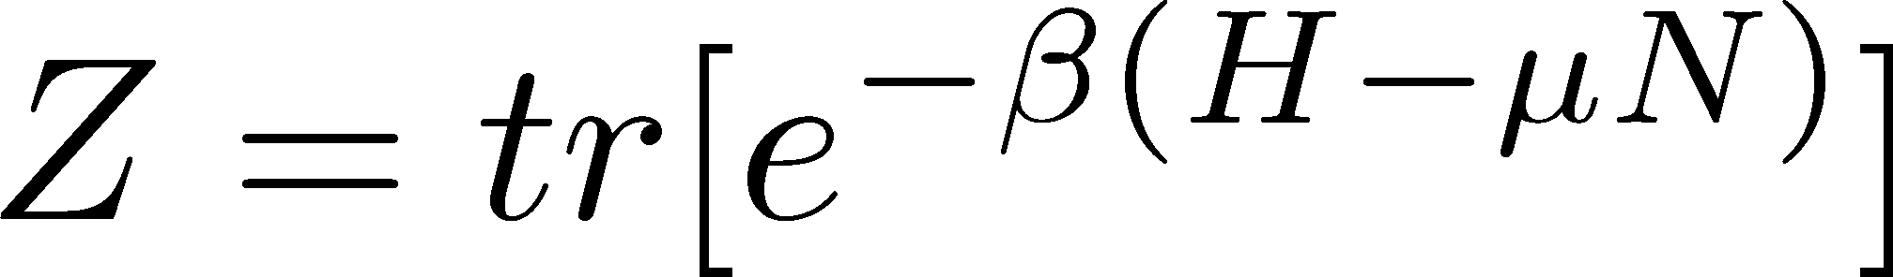
Baryon Number Fluctuations are Better
than proton’s since it is not a conserved charge
simple theoretical treatment for conserved charges
possible slow diffusion in hadronic stage
Asakawa, Heintz, Muller, 2000; Jeon, Koch, 2000

Slide 29
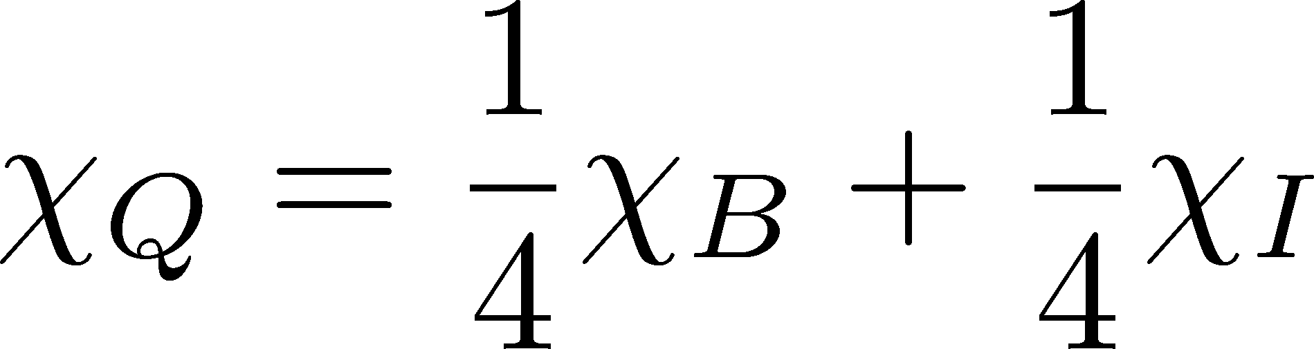
Baryon Number Fluctuations are Better
than proton’s since it is not a conserved charge
simple theoretical treatment for conserved charges
possible slow diffusion in hadronic stage
Asakawa, Heintz, Muller, 2000; Jeon, Koch, 2000
than electric charge fluctuations
additional nonsingular contribution in Q
Example:
singular nonsingular

Slide 30
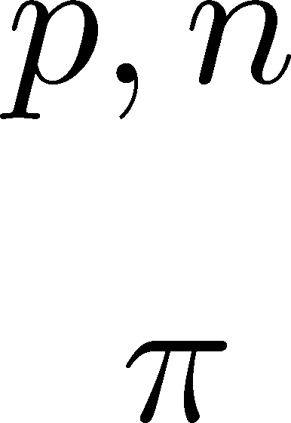
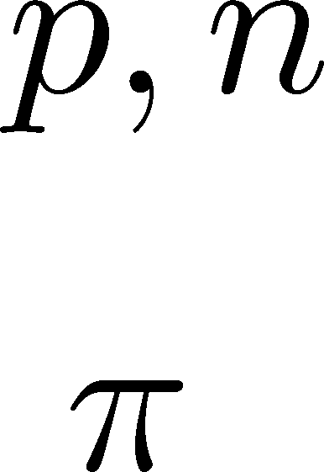





Variation of Proton # in Hadronic Phase
Proton number varies even after chemical freezeout
via charge exchange reactions mediated by Δ(1232):
200mb=20fm²
cross section

Slide 31










Δ(1232)
cross sections of p
3
1
2:1
2
1:2
decay rates of Δ

Slide 32



Δ(1232)
cross sections of p
3
1
2:1
2
1:2
decay rates of Δ

Slide 33




Δ(1232)
cross sections of p
3
1
2:1
2
1:2
decay rates of Δ
BW for σ & thermal pion
Lifetime to create Δ⁺ or Δ⁰
c.f.) Nonaka, Bass, 2007

Slide 34





Baryon & Proton Number Fluctuations
In general, fluctuations of N_{N} and N_{p} are different.
Due to the isospin fluctuations, N_{p} fluctuations tend to be close to equilibrium ones than N_{N} fluctuations.

Slide 35






Slot Machine Analogy
= +
P (N)
N
P (N)
N

Slide 36
Examples
常に一定の枚数のコイン
どの枚数も一定確率
N
N
N
N

Slide 37


Slot Machine Analogy
P (N )= P (N )B_{1/2}(N ;N )
：二項分布関数

Slide 38

Isospin Distributions
Large pion density
Small nucleon density because M_{N}/T<<1
For top RHIC energy, N_{π}~20N_{N}
Nucleons exclusively interact with pions
Rare NN collisions
Huge ππ reactions
Nonaka, Bass, ‘07
All formations and decays of Δ
take place independently

Slide 39




Nucleons in Hadronic Phase
time
chem. f.o.
hadronize
~20fm
kinetic f.o.
rare NN collisions
no quantum corr.
mesons
baryons
many pions

Slide 40







Probability Distribution
Detector
binomial distribution func.
for any phase space in the final state.

Slide 41


Baryon & Proton Number Fluctuations
For free gas
for isospin symmetric medium
Similar formulas up to any order!

Slide 42

Free Nucleon Gas
Poisson distribution P_{λ}(N)

Slide 43
Free Nucleon Gas
Poisson distribution P_{λ}(N)
The factrization is satisfied in free nucleon gas.

Slide 44






Time Scales
Time scales of fireballs:
: time scale to realize isospin binomiality
: time scale of baryon number diffusion
: life-time of hadronic medium in HIC
hadronize

Slide 45


Effect of Isospin Distribution
(1)
deviates from the equilibrium value.
(2) Boltzmann (Poisson) distribution for

Slide 46


Effect of Isospin Distribution
(1)
deviates from the equilibrium value.
(2) Boltzmann (Poisson) distribution for
genuine info.
noise
For free gas

Slide 47


Example : 3rd Moment
beyond the QCD phase boundary
near the CP
Asakawa, Ejiri, MK, 2009
Fireballs forget negative moment
over the QCD mountains?
No. Not necessarily.
Note:

Slide 48

Example1 : 4th/2nd
RBC-Bielefeld ’09
~ 1 (hadron)
~ 1/9 (quark)
< 0 (near CP)
Ejiri, Karsch, Redlich, 2006
Stephanov, 2011
Fireballs forget primordial flucs?
No. Not necessarily.
No suppression

Slide 49













Strange Baryons
Decay Rates:
Decay modes:
Regarding these ratios even, protons from these decays
is incorporated into the binomial distribution. Then, N_{N}→N_{B}

Slide 50
Summary
Baryon and proton number fluctuations are different in nonequilibrium medium. To see non-thermal contribution, baryon number is better.
Formulas to reveal baryon # cumulants in experiments.
Experimental analysis of baryon # fluctuations may verify
  signals of QCD phase transition
  speed of baryon number diffusion in the hadronic stage.
Future Work
Refinement of the formulas to incorporate
nonzero isospin density / low beam-energy region
Distribution function itself
Discussion on time evolution of fluctuations @STAR

Slide 51




Nucleon Time Scales in Fireballs
Freeze-out time
Mean time to create Δ^{+,0}
Nonaka, Bass, 2007

Slide 52




3rd & 4th Order Fluctuations

